Slide 1

Does the CMS SEP1 Measure Positively Impact Patient Care?
A Panel Discussion
Panel Members:
Dr. Donald Jansen – Family Medicine (Moderator)
Dr. Edwin Annan – Critical Care Medicine
Dr. Mohamed Jahangir – Hospitalist
Dr. Chiedu Onunkwo – Infectious Disease
Dr. Mark Quiring – Emergency Medicine
Eli Opacich – Pharmacist
Kim Moore – Sepsis Abstractor
Kh 2020

Slide 2

There are several definitions for sepsis (CMS definition, SCCM definition, etc.) , which is the most clinically relevant and why?

Slide 3
Sepsis: an evolving definition
Year | Definition Name or identifier | Defining elements
1987 | Bone’s methylprednisolone trial | Inflammatory criteria, >1 organ dysfunction, (AMS, hypoxemia, elevated lactate, oliguria)
1991 | AACP; SCCM Definitions Conference (Sepsis-1) | Septicemia abandoned SIRS concept proposed, not defined Categories of Sepsis, Severe Sepsis, and septic shock established MODS terminology
2001 | AACP, SCCM, ATS, ESIM, SIS (Sepsis- 2 ) | Expanded SIRS criteria Sepsis syndromes similar to Sepsis -1 PIRO stratification: Predisposition, Insult, Response, Organ dysfunction
2015 | Centers for Medicare and Medicare Services (based upon Sepsis- 1 &2) | Sepsis: Suspected infection with SIRS Severe sepsis: Sepsis and organ dysfunction including lactate > 2 Septic shock: Severe sepsis with persistent hypotension AND/OR lactate >4
2016 | Third International Consensus Definitions for Sepsis and Septic Shock (Sepsis -3) | Severe sepsis abandoned Focus on organ failure/dysfunction Sepsis: organ failure focus including vasopressor dependent hypotension Septic shock: Vasopressor dependent hypotension AND elevated lactate ≥ 2
2016 | Surviving Sepsis Campaign | Severe sepsis abandoned Sepsis: previous severe sepsis (lactate qualifies, no vasopressor dependent hypotension) Septic shock: previous septic shock (includes all vasopressor dependent hypotension + lactate)

Slide 4

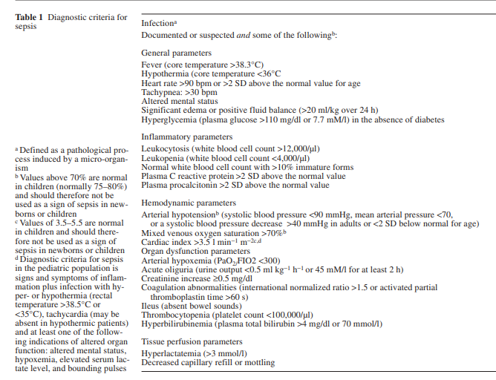
Sepsis-2
SIRS and SEPSIS definitions

Slide 5
Sepsis: an evolving definition
Year | Definition Name or identifier | Defining elements
1987 | Bone’s methylprednisolone trial | Inflammatory criteria, >1 organ dysfunction, (AMS, hypoxemia, elevated lactate, oliguria)
1991 | AACP; SCCM Definitions Conference (Sepsis-1) | Septicemia abandoned SIRS concept proposed, not defined Categories of Sepsis, Severe Sepsis, and septic shock established MODS terminology
2001 | AACP, SCCM, ATS, ESIM, SIS (Sepsis- 2 ) | Expanded SIRS criteria Sepsis syndromes similar to Sepsis -1 PIRO stratification: Predisposition, Insult, Response, Organ dysfunction
2015 | Centers for Medicare and Medicare Services (based upon Sepsis- 1 &2) | Sepsis: Suspected infection with SIRS Severe sepsis: Sepsis and organ dysfunction including lactate > 2 Septic shock: Severe sepsis with persistent hypotension AND/OR lactate >4
2016 | Third International Consensus Definitions for Sepsis and Septic Shock (Sepsis -3) | Severe sepsis abandoned Focus on organ failure/dysfunction Sepsis: organ failure focus including vasopressor dependent hypotension Septic shock: Vasopressor dependent hypotension AND elevated lactate ≥ 2
2016 | Surviving Sepsis Campaign | Severe sepsis abandoned Sepsis: previous severe sepsis (lactate qualifies, no vasopressor dependent hypotension) Septic shock: previous septic shock (includes all vasopressor dependent hypotension + lactate)

Slide 6
CMS utilizes the Sepsis -1 &2 definitions
Sepsis | > 2 SIRS criteria + known or suspected infection
Severe Sepsis | SEPSIS AND at least 1 sign of organ dysfunction: Sepsis induced hypotension SBP < 90 MAP < 65 mm Hg Dec. in SBP by > 40 mm Hg from baseline CR > 2.0 or u/o < 0.5 ml/hg/hr Bilirubin > 2.0 mg/dL Platelet < 100,000/mm3 INR > 1.5 or PTT > 60 sec Lactate > 2 mmol/L Acute respiratory failure (new need for BiPAP or ETT)
Septic Shock | Severe Sepsis AND Persistent hypotension after 30 mL/kg crystalloid bolus AND/OR Lactate > 4 mmol/L Levy, 2003
Focused on adherence to the 3 and 6 hour treatment bundles

Slide 7
Sepsis: an evolving definition
Year | Definition Name or identifier | Defining elements
1987 | Bone’s methylprednisolone trial | Inflammatory criteria, >1 organ dysfunction, (AMS, hypoxemia, elevated lactate, oliguria)
1991 | AACP; SCCM Definitions Conference (Sepsis-1) | Septicemia abandoned SIRS concept proposed, not defined Categories of Sepsis, Severe Sepsis, and septic shock established MODS terminology
2001 | AACP, SCCM, ATS, ESIM, SIS (Sepsis- 2 ) | Expanded SIRS criteria Sepsis syndromes similar to Sepsis -1 PIRO stratification: Predisposition, Insult, Response, Organ dysfunction
2015 | Centers for Medicare and Medicare Services (based upon Sepsis- 1 &2) | Sepsis: Suspected infection with SIRS Severe sepsis: Sepsis and organ dysfunction including lactate > 2 Septic shock: Severe sepsis with persistent hypotension AND/OR lactate >4
2016 | Third International Consensus Definitions for Sepsis and Septic Shock (Sepsis -3) | Severe sepsis abandoned Focus on organ failure/dysfunction Sepsis: organ failure focus including vasopressor dependent hypotension Septic shock: Vasopressor dependent hypotension AND elevated lactate ≥ 2
2016 | Surviving Sepsis Campaign | Severe sepsis abandoned Sepsis: previous severe sepsis (lactate qualifies, no vasopressor dependent hypotension) Septic shock: previous septic shock (includes all vasopressor dependent hypotension + lactate)

Slide 8
Sepsis 3 …
Purpose, to differentiate between sepsis and uncomplicated infection & improve consistency and specificity of language used
  Sepsis is a “life threatening” organ dysfunction caused by a dysregulated host response to infection,” can be identified by a change of 2 or more points in a patient's Sequential Organ Failure Assessment (SOFA) score
  CMS will NOT use or transition to the newer Sep3 definitions at this time due to “significant” lack of evidence

Slide 9
SEPSIS -3
3RD INTERNATIONAL CONSCENSUS DEFINITIONS FOR SEPSIS AND SEPTIC SHOCK ⁹ Summary
 | UNCOMPLICATED INFECTION | SEPSIS (Mortality >10%) | SEPTIC SHOCK (Mortality >40%)
DEFINITION | No Sepsis or Septic shock | Life threatening ORGAN DYSFUNCTION caused by a DYSREGULATED HOST RESPONSE to INFECTION | Subset of Sepsis in which profound circulatory, cellular and metabolic abnormalities are associated with greater mortality
CLINICAL DETERMINATION |  | Infection + Organ dysfunction (SOFA* score that increased by ≥ 2 points) SOFA Score OR qSOFA score Encephalopathy Blood pressure (systolic) < 100 Respiratory rate ≥ 22 | Patient with Sepsis + Vasopressors needed to maintain MAP >65 after 30ml/kg fluid bolus AND Lactic acid level ≥ 2 No hypovolemia
*Sepsis related Organ Failure Assessment

Slide 10
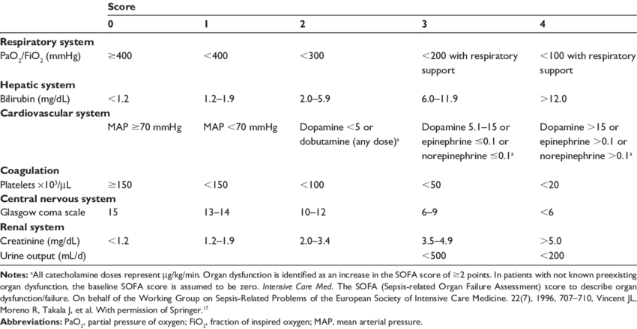
The SOFA SCORE ¹⁰

Slide 11
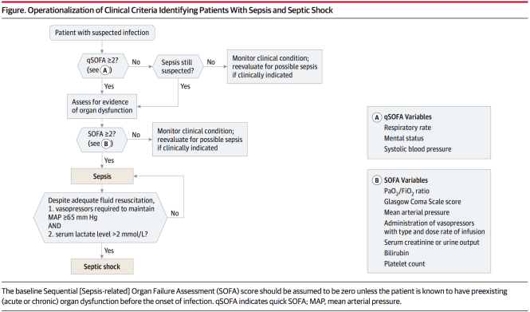
9

Slide 12
Sepsis – 3 …..
Goal /Conclusions
  to differentiate between sepsis and uncomplicated infection
  to improve consistency and specificity of language by removing severe sepsis definition
  SIRS alone too non-specific and unhelpful in identifying Sepsis
Problems
  Concluded there was no Gold Standard diagnostic process to operationalize the definitions of sepsis and septic shock. (No standard criteria to follow).
  New definitions did not make reportability easier.

Slide 13
Sepsis definition summary
 | Sepsis 1 & Sepsis 2 | CMS (Core measure) | Sepsis 3
SIRS | Yes | Yes | Downplays utility
SEPSIS | SIRS + Infection | SIRS + infection | Infection + Life threatening organ dysfunction (qSOFA ≥ 2)
SEVERE SEPSIS | End organ dysfunction or lactate > 4 | Sepsis + lactate ≥ 2 | N/A
SEPTIC SHOCK | Persistent hypotension | Persistent hypotension And/OR lactate ≥ 4 | Persistent hypotension AND Lactate ≥ 2

Slide 14
CMS utilizes the Sepsis -1 &2 definitions
Sepsis | > 2 SIRS criteria + known or suspected infection
Severe Sepsis | SEPSIS AND at least 1 sign of organ dysfunction: Sepsis induced hypotension SBP < 90 MAP < 65 mm Hg Dec. in SBP by > 40 mm Hg from baseline CR > 2.0 or u/o < 0.5 ml/hg/hr Bilirubin > 2.0 mg/dL Platelet < 100,000/mm3 INR > 1.5 or PTT > 60 sec Lactate > 2 mmol/L Acute respiratory failure (new need for BiPAP or ETT)
Septic Shock | Severe Sepsis AND Persistent hypotension after 30 mL/kg crystalloid bolus OR Lactate > 4 mmol/L Levy, 2003
CMS SEP1 Measure
Focused on adherence to the 3 and 6 hour treatment bundles
Pass or fail measure
  Retrospective review of sepsis patients
  7 component metrics

Slide 15
CMS SEP1 Requirements 2019
Required action | Severe sepsis 3 Hr treatment 6 Hr treatment |  | Septic shock
Initial lactate collection | yes | Must be completed within 3 hours of severe sepsis presentation
Blood culture collection | Yes
Initial antibiotic started | Yes
Repeat lactate collection (if initial >2) | NA | Yes | Completed within 6 hours of Severe Sepsis presentation
30 ml/kg crystalloid fluid started | NA | NA | Completed within 3 hours of initial hypotension and/or septic shock
Vasopressor given (if hypotension persists | NA | NA | Complete within 6 hours of septic shock
Repeat volume status assessment | NA | NA

Slide 16
SEP1 Abstraction….

Slide 17
Medicare.gov
Hospital Compare
Timely and effective care: Sepsis care
Percentage of patients who received appropriate care for severe sepsis and septic shock
2018
Goshen Hospital | Parkview Hospital | LaPorte | St Joe Regional | Memorial of SB | Elkhart General | Indiana average | National average
38% 303 patients | 80% 103 patients | 47% 283 patients | 60% 152 patients | 43% 674 patients | 55% 199 patients* | 53% | 57%
*Hospitals may chose to submit all cases to CMS or a random sample
EGH submits a random sample

Slide 18
Elkhart General Hospital

Slide 21
There is some data that suggests that each elapsed hour between presentation and antibiotic administration is associated with a 9% increase in the odds of mortality in patients with sepsis (all severity strata)
  Is there concern that the rush to treat may result in overuse of broad spectrum antibiotics/antimicrobials?
5

Slide 22

Do you believe the data suggesting that early administration of antibiotics is the only reason for the improvement in sepsis mortality?

Slide 23
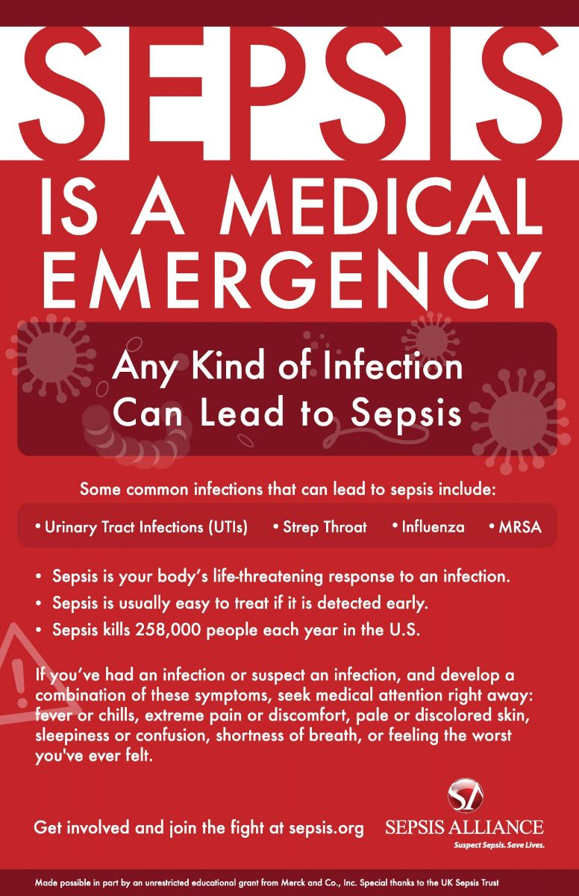
Do all sepsis patients require broad spectrum antibiotics?
2,7

Slide 24
When/how do you determine to de-escalate antimicrobials?

Slide 25

What’s is the role of PCR guided blood culture results?

Slide 26
When is procalcitonin helpful in determining whether to treat with antibiotics?
  What are the limitations of procalcitonin?

Slide 27
What are the challenges adhering to the CMS SEP1 measure (e.g., weight based fluid bolus)?
What are some of the challenges associated with timely treatment of sepsis (e.g., patient disposition)?

Slide 28
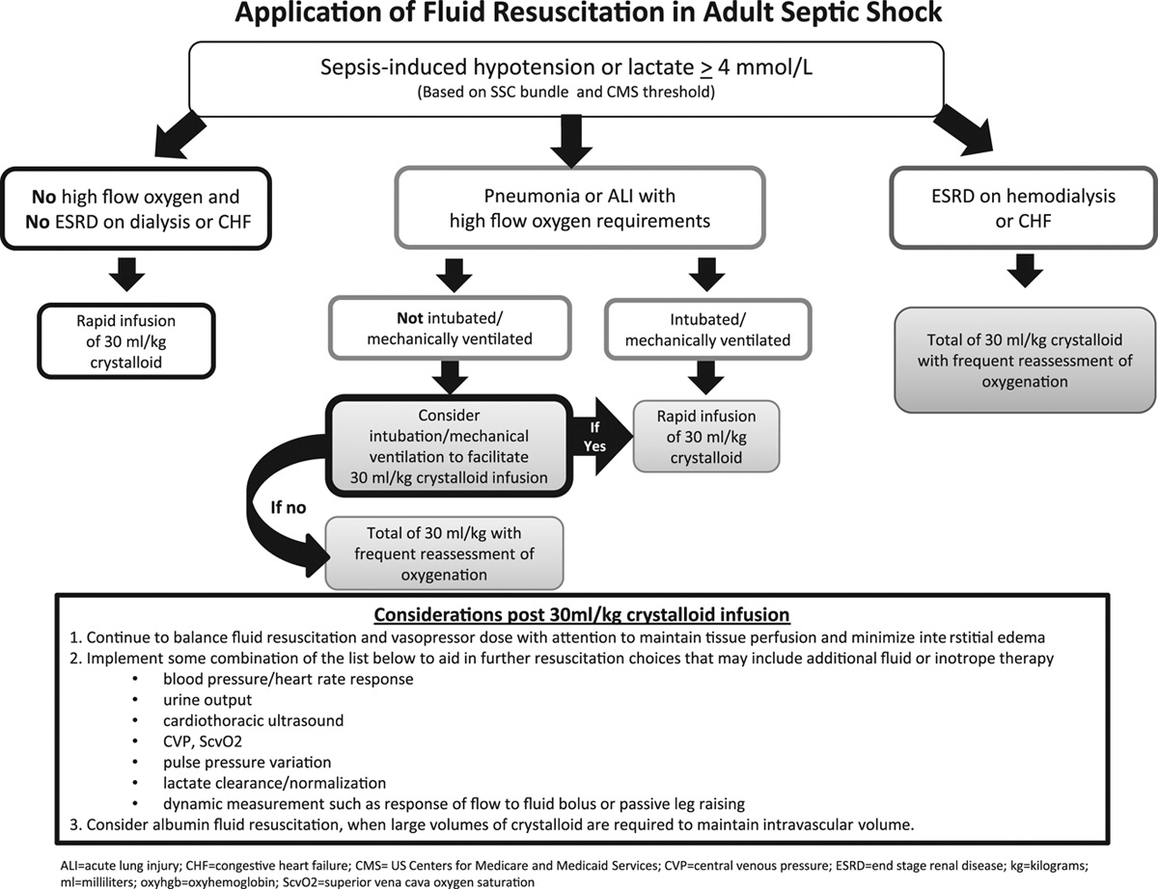
A Users’ Guide to the 2016 Surviving Sepsis Guidelines
Critical Care Medicine45(3):381-385, March 2017.

Slide 29
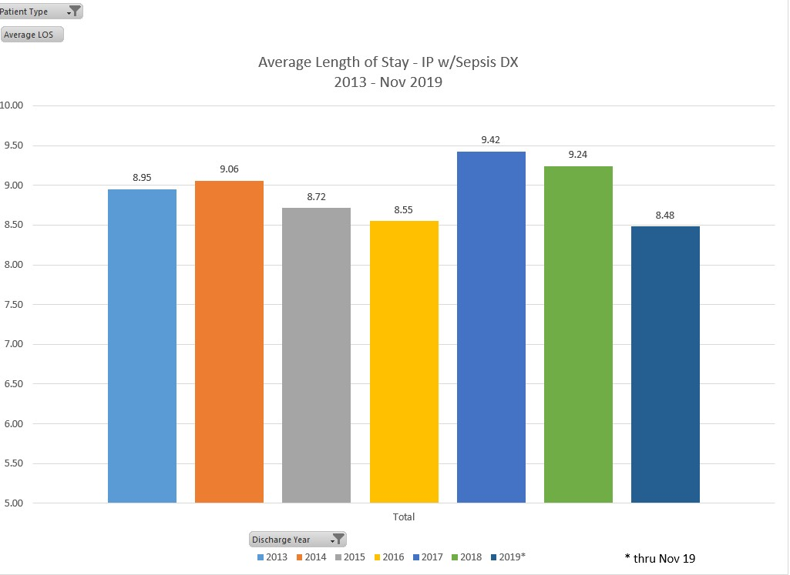
Elkhart General Hospital

Slide 30
Sepsis Mortality > 10%
Septic Shock mortality > 40%
The Third International Consensus Definitions for Sepsis and Septic Shock (Sepsis-3)
Elkhart General Hospital

Slide 31
Elkhart General Hospital

Slide 32
Elkhart General Hospital

Slide 33
The IDSA CAP guidelines have been updated… can you discuss changes as relates to ….
  Removal of the HCAP designation
  Aspiration pneumonia treatment

Slide 34
Questions?

Slide 35
References
Bone RC , Fisher CJ, et al. A controlled clinical trial of high dose methylprednisolone in the treatment of severe sepsis and septic shock. New Engl J med. 1987; 317 (11): 653-8
Disselkamp M, Coz Y, et. al. POINT: Should Broad –Spectrum Antibiotics Be Routinely Administer to All Patients with Sepsis as Soon as Possible? Yes. Chest. 2019; 156(4): 645-647
Levy MM, Fink M, et al. 2001 SCCM/SSICM/ACCP/ATS/SIS International Sepsis Definitions Conference. Intensive Care med. 2003; 29: 530-538
Levy MM, Dellinger RP, Townsend SR, et al. The Surviving Sepsis Campaign: results of an international guideline-based performance improvement program targeting severe sepsis. Intensive Care Med. 2010;36(2):222-231.
Liu V, Fielding-Singh V, et al. The timing of early antibiotics and hospital mortality in sepsis. American Journal of Respiratory and Critical Care Medicine. 2017; 196(7)
Metlay J, Waterer G, et al. Diagnosis and treatment of adults with community acquired pneumonia. An official clinical practice guideline of the American Thoracic Society and Infection Diseases Society of America. American Journal of Respiratory and Critical Care medicine. 2019; 200(7)
Patel JJ, Bergl PA. COUNTERPOINT: Should Broad Spectrum Antibiotics Be Routinely Administered to All Patients With Sepsis as Soon as Possible:? No. Chest. 2019; 156(4): 647-649
Rhee C , Zhang Z, et al. Sepsis Surveillance Using Adult Sepsis Events Simplified eSOFA Criteria Versus Sepsis -3 Sequential Organ Failure Assessment Criteria. Critical Care Medicine. 2016; 47(3): 307-314
Singer M, Deutschman C, Seymour CW, et al. The Third International Consensus Definitions for Sepsis and Septic Shock (Sepsis-3). JAMA. doi:10.1001/jama.2016.0287
Vincent JL, Moreno R, Takala J, et al. The SOFA (Sepsis-related Organ Failure Assessment) score to describe organ dysfunction/failure. Intensive Care Med. 1996;22:707–710.

