Slide 1

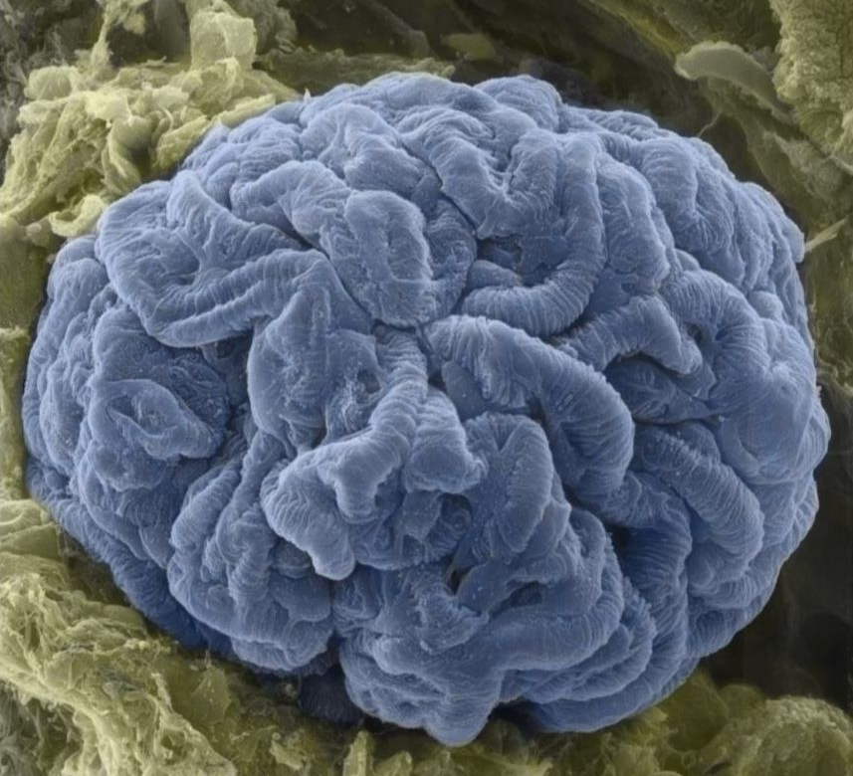
Chronic Kidney Disease- Updates
SUDHIR VYAKARANAM
MD MPH FASN FNKF
Consultant Nephrologist, Neph Phys LLC
Clinical Asst Prof of Med, IUSOM-SB
Director, Acute Dialysis Services, North Central Indiana Region

Slide 2
Credits/ Disclosure
Sources-
NKF kidney education modules.
  USRDS/ UNITED STATES RENAL DATA SYSTEM - National data system that collects, analyzes, and distributes information about CKD/ESRD. Funded directly by the National Institute of Diabetes and Digestive and Kidney Diseases (NIDDK).
ASN Nephsap. CKD Volume 18, Number 4, September 2019
Uptodate
Glomerulus EM pic- http://www.histologyguide.com
Speaker Panel for ACTHAR (Mallinckrodt Pharma)

Slide 3
TERMINOLOGY
ESRD/ END STAGE RENAL DISEASE
  Hemodialysis
  Peritoneal Dialysis
  Kidney transplantation
  CKD / CHRONIC KIDNEY DISEASE
  “Impaired renal function” who do not need renal replacement therapy

Slide 4
Learning Objectives
Epidemiology of CKD
Risk factors
Screening / Evaluation
CKD management

Slide 5
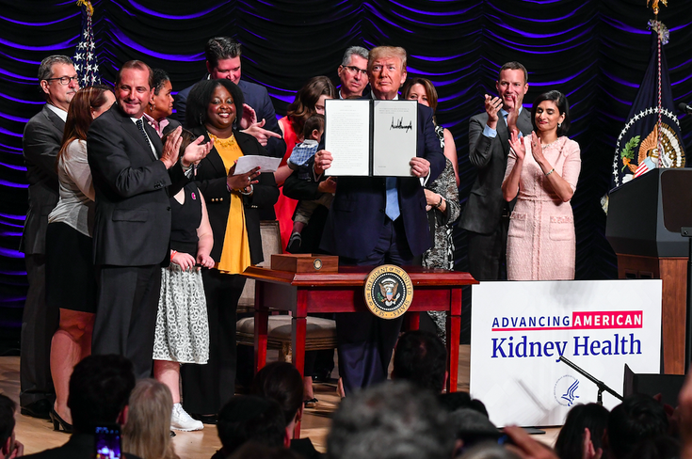
Dawn of a new age in kidney disease
HEALTH
Notes:
On July 10, 2019 the President launched the Advancing American Kidney Health Initiative at an event in Washington, DC, taking the largest steps forward in U.S. kidney care since the end-stage renal disease (ESRD) program began in 1973.

Slide 6

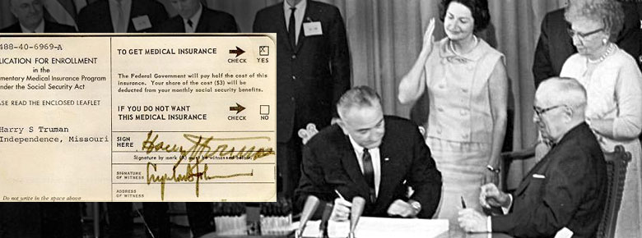
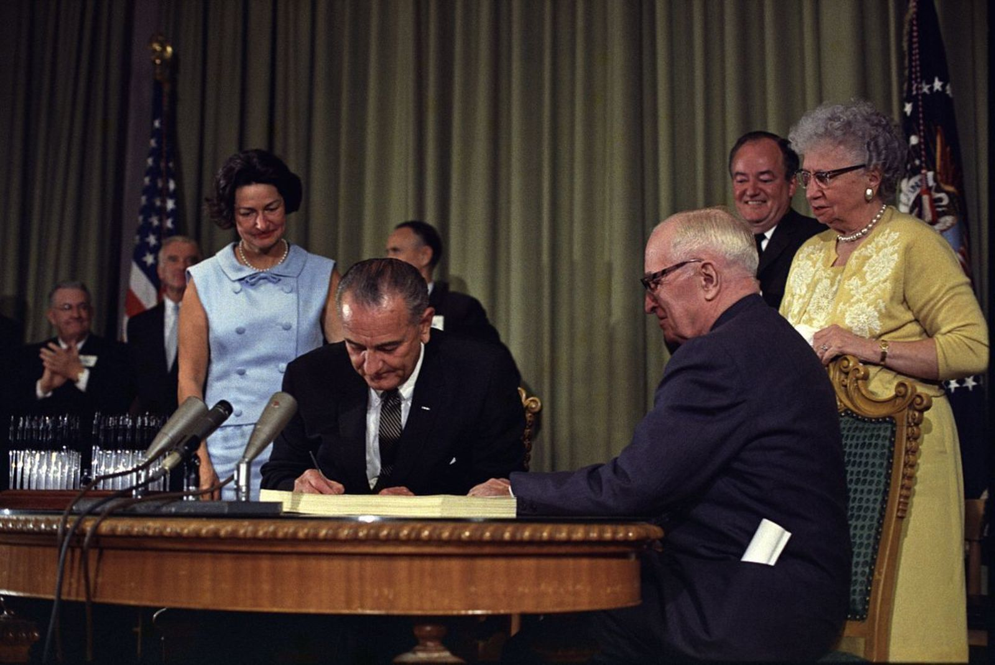
MEDICARE
July 30, 1965 - President Lyndon B. Johnson signed H.R. 6675
1966 - Nineteen million individuals signed.
1972- President Nixon – under the age of 65 with long-term disabilities and individuals with ESRD.
Notes:
The ’60s
On July 30, 1965 President Lyndon B. Johnson made Medicare law by signing H.R. 6675 in Independence, Missouri. Former President Truman was issued the very first Medicare card during the ceremony. In 1965, the budget for Medicare was around $10 billion.
In 1966, Medicare’s coverage took effect, as Americans age 65 and older were enrolled in Part A and millions of other seniors signed up for Part B. Nineteen million individuals signed up for Medicare during its first year.
The ’70s
In 1972, President Richard M. Nixon signed into the law the first major change to Medicare. The legislation expanded coverage to include individuals under the age of 65 with long-term disabilities and individuals with end-stage renal disease (ERSD). People with disabilities have to wait for Medicare coverage, but Americans with ESRD can get coverage as early as three months after they begin regular hospital dialysis treatments – or immediately if they go through a home-dialysis training program and begin doing in-home dialysis. This has served as a lifeline for Americans with kidney failure – a devastating and extremely expensive diseas

Slide 7
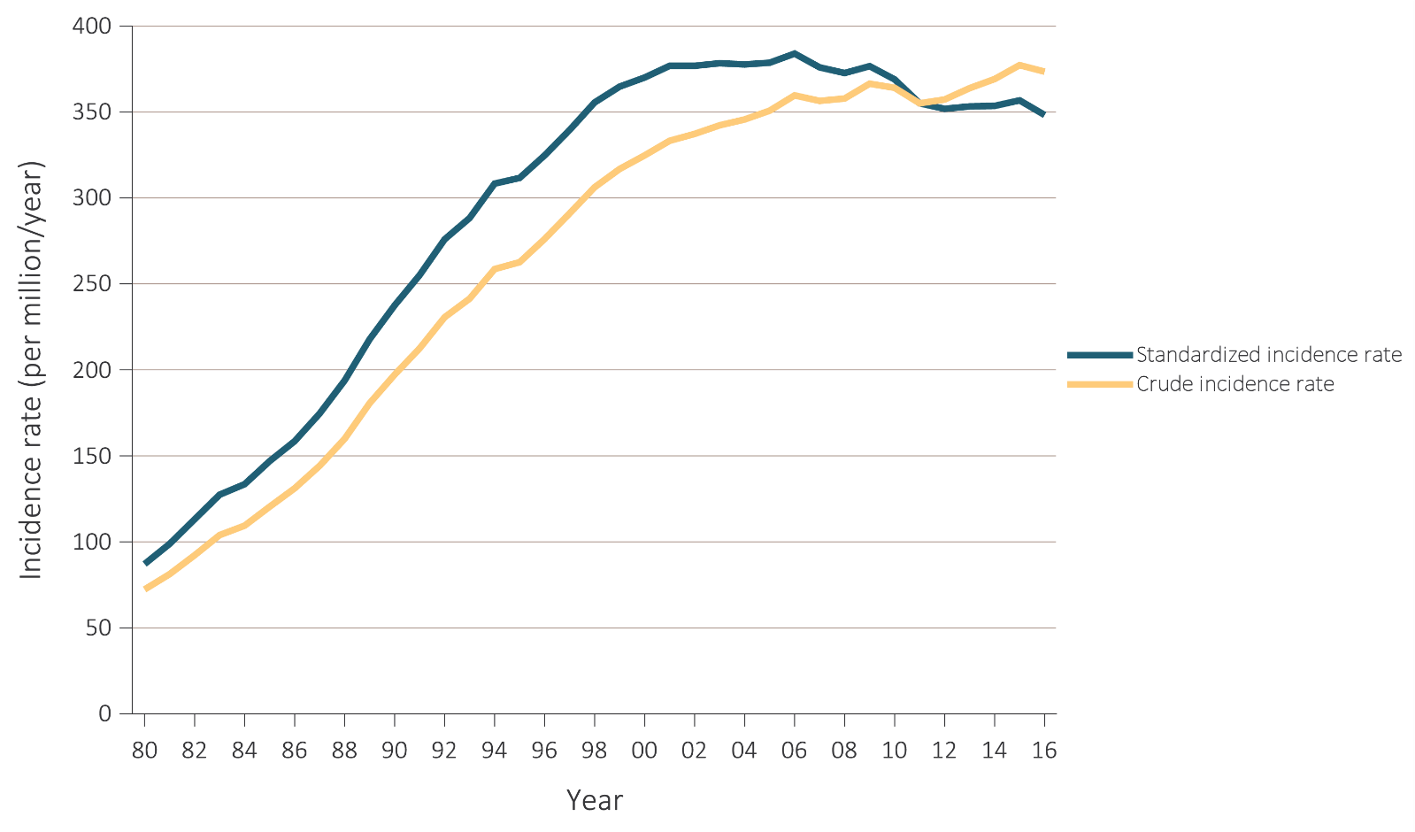
TRENDS IN THE CRUDE AND STANDARDIZED INCIDENCE RATES OF ESRD
2011
2016- 124,675 newly reported cases of ESRD
Notes:
In 2016, there were 124,675 newly reported cases of ESRD; the unadjusted (crude) incidence rate was 373.4 per million/year (Table 1.1). Since 2011, the crude rate had risen; however, the standardized rate appears to have plateaued (Figure 1.1).

Slide 8
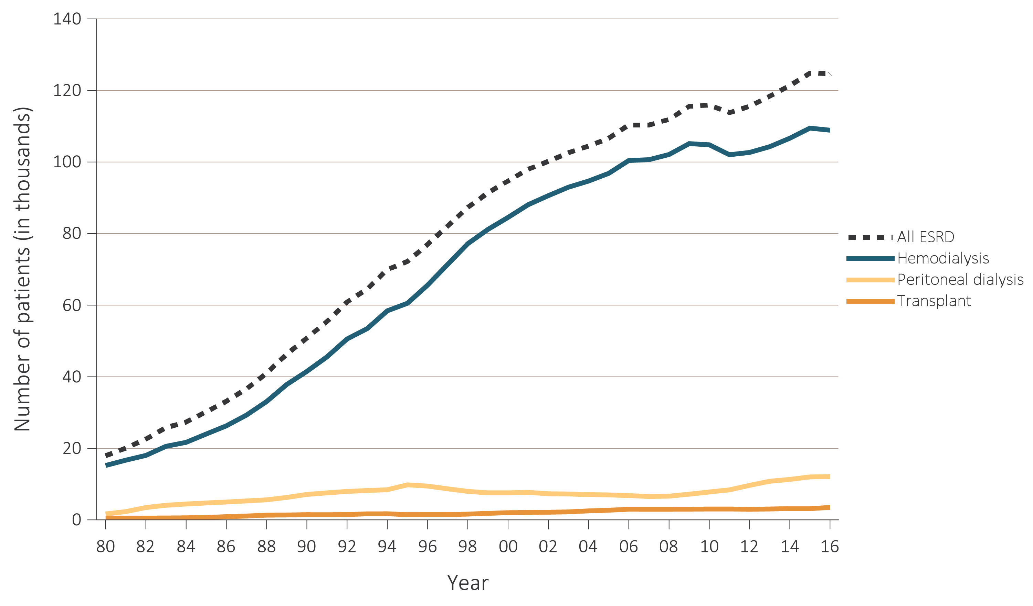

Trends in the annual number of ESRD Prevalent cases 1980-2016
Data Source: Reference Table D.1 and special analyses, USRDS ESRD Database. Persons with “Uncertain Dialysis” were included in the “All ESRD” total, but are not represented separately. Abbreviation: ESRD, end-stage renal disease.
Notes:
On December 31, 2016, there were 726,331 prevalent cases of ESRD; the crude prevalence was 2,160.7 per million in the U.S. population

Slide 9
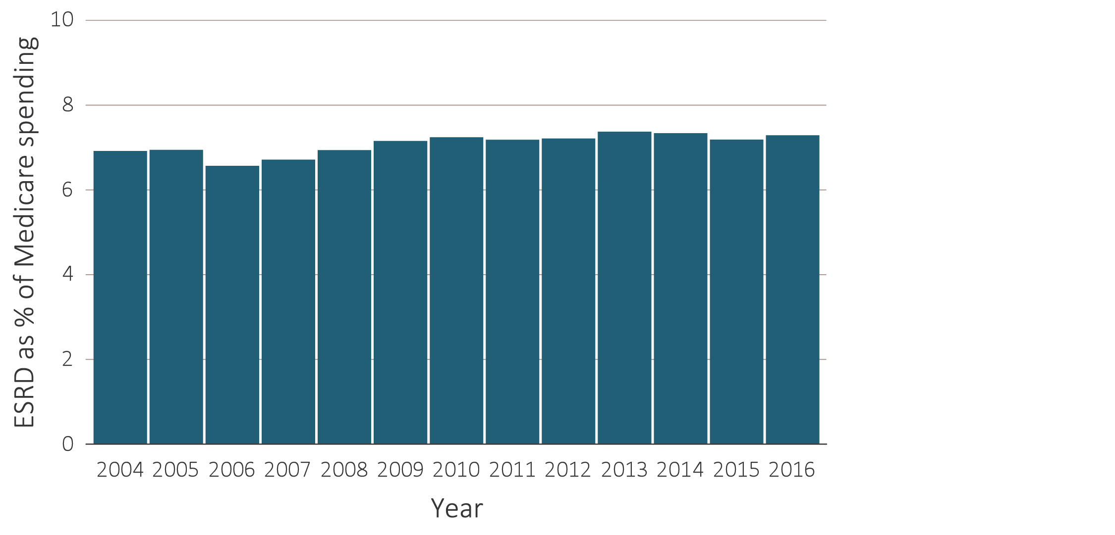
ESRD SPENDING/ TOTAL MEDICARE FFS SPENDING
Medicare 2016- $35.4 billion
Less than 1% of the total Medicare population
7% of Medicare fee-for-service
Notes:
Despite the magnitude of the resources committed to the treatment of ESRD and the substantial improvements in the quality of dialysis therapy, these patients continue to experience significant mortality and morbidity and a reduced quality of life..

Slide 10
Epidemiology of CKD

Slide 11
CKD as a Public Health Issue
Prevalence of CKD (stages 1-5) - 14.8% in 2013-2016.
CKD 3 (6.4%) - Most Prevalent
Correlation with aging population
CKD - 9th leading cause of death in US.
Since 2016, deaths attributed to CKD - remained stable in US but 100 % increase globally.
Notes:
As populations live longer and grow older, the total number of adults with CKD increases.

Slide 12
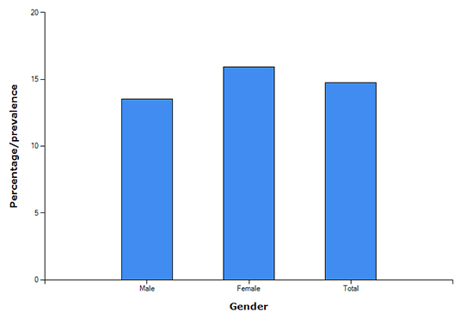
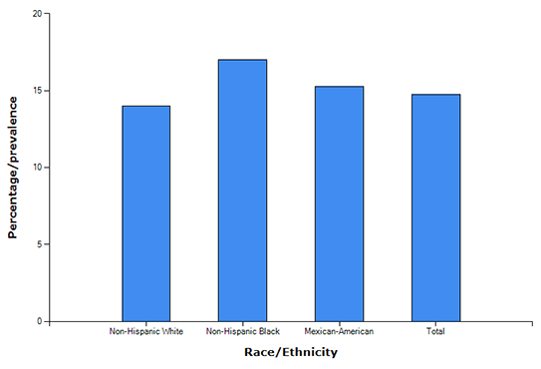
Demographics of CKD
Notes:
Women (15.93 percent) are more likely to have stages 1 to 4 CKD than men (13.52 percent)
African Americans (17.01 percent) and Mexican Americans (15.29 percent) are more likely to have CKD than Caucasians (13.99 percent).

Slide 13
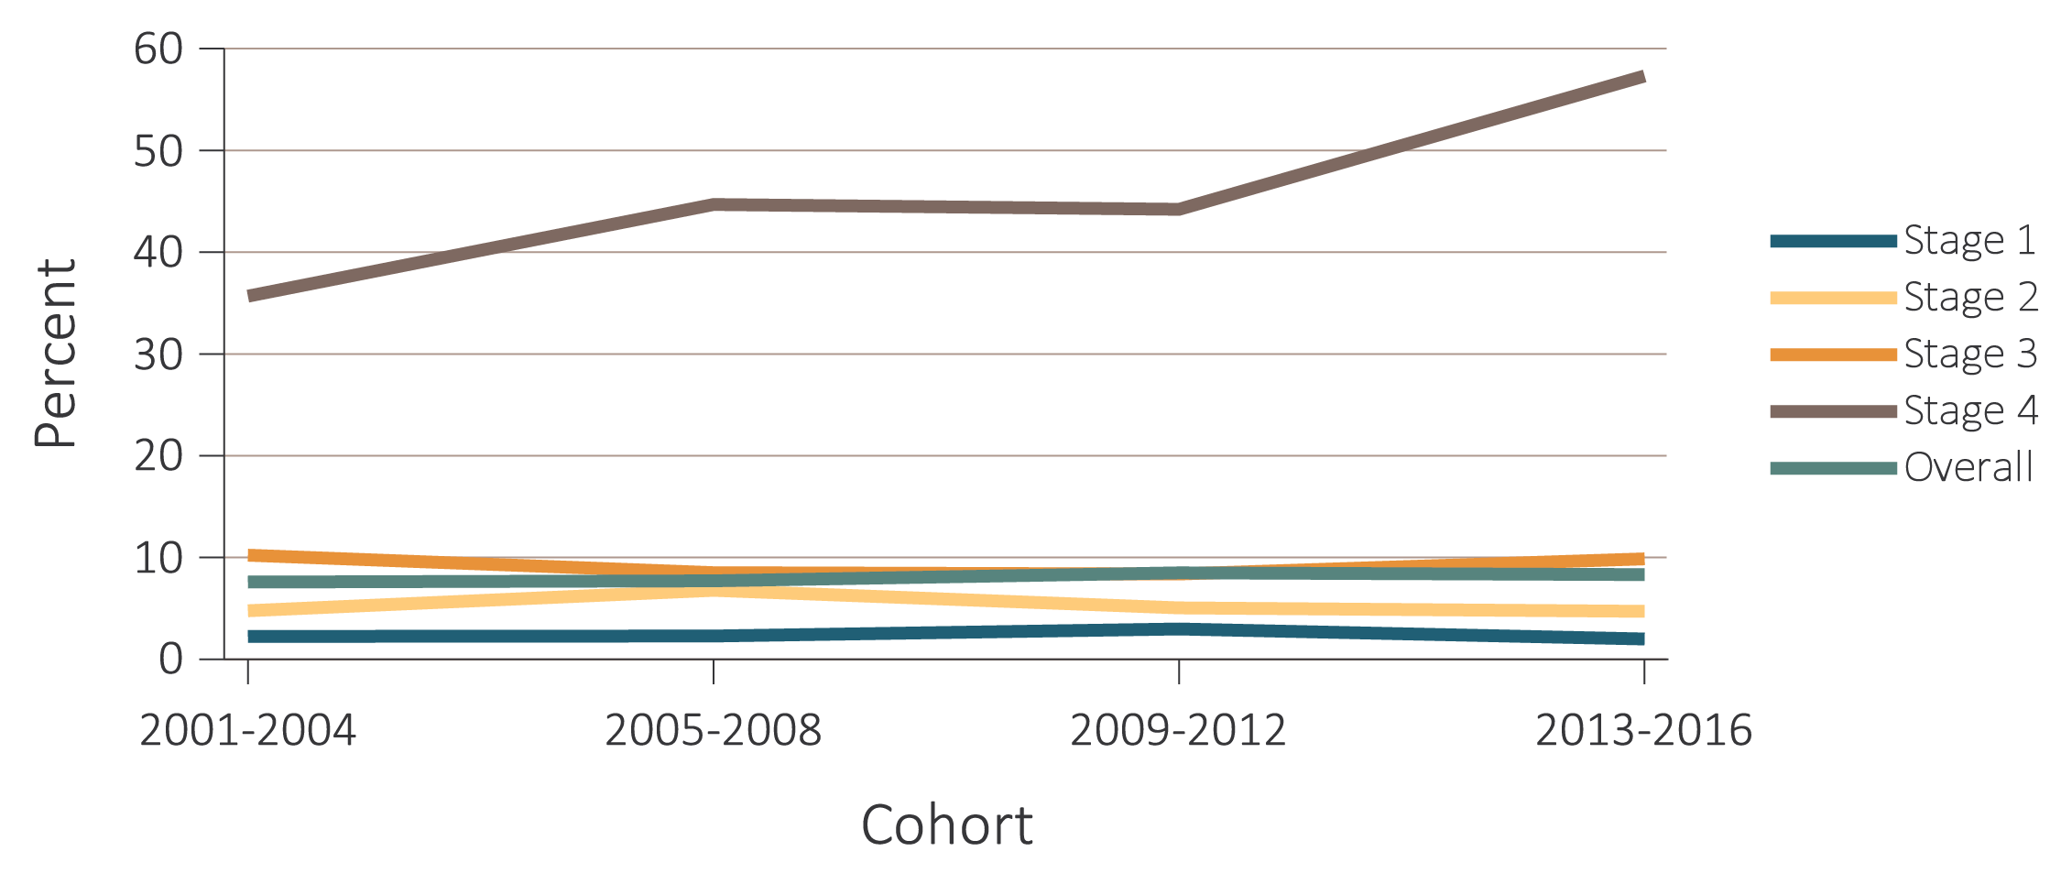
“Silent Disease” - CKD Awareness NHANES 2001-2016
Notes:
Among the individuals who were classified by laboratory measurements as having CKD, the percentage who were aware of their kidney disease remained low from 2001-2016 (Figure 1.13). There is a suggestion of an improvement among individuals with Stage 4 CKD between 2009-2012 and 2013-2016. We do not present awareness data for those in Stage 5 CKD because of a very small sample size. When examined by eGFR <60 vs. ACR >30, awareness was markedly higher for individuals who had both conditions.
When examining awareness by conditions that are known risk factors for CKD (DM and HTN), awareness was still very low. Even among individuals with both conditions, awareness was steady around 15% (Figure 1.13.c). Figure 1.13.d displays awareness by age categories, and while older patients have slightly better awareness, those 60+ years only reached 10% in the most recent cohort (2013-2016).

Slide 14
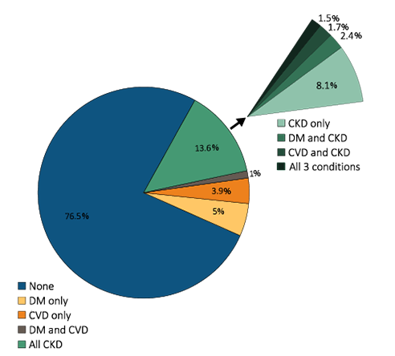
“Disease Multiplier”- CKD-CVD-Diabetes Link
50% of CKD pts also have DM2 and CVD.
Notes:
CKD often occurs in the context of multiple comorbidities and has been termed a “disease multiplier.”
Almost half of individuals with CKD also have diabetes and CVD.

Slide 15
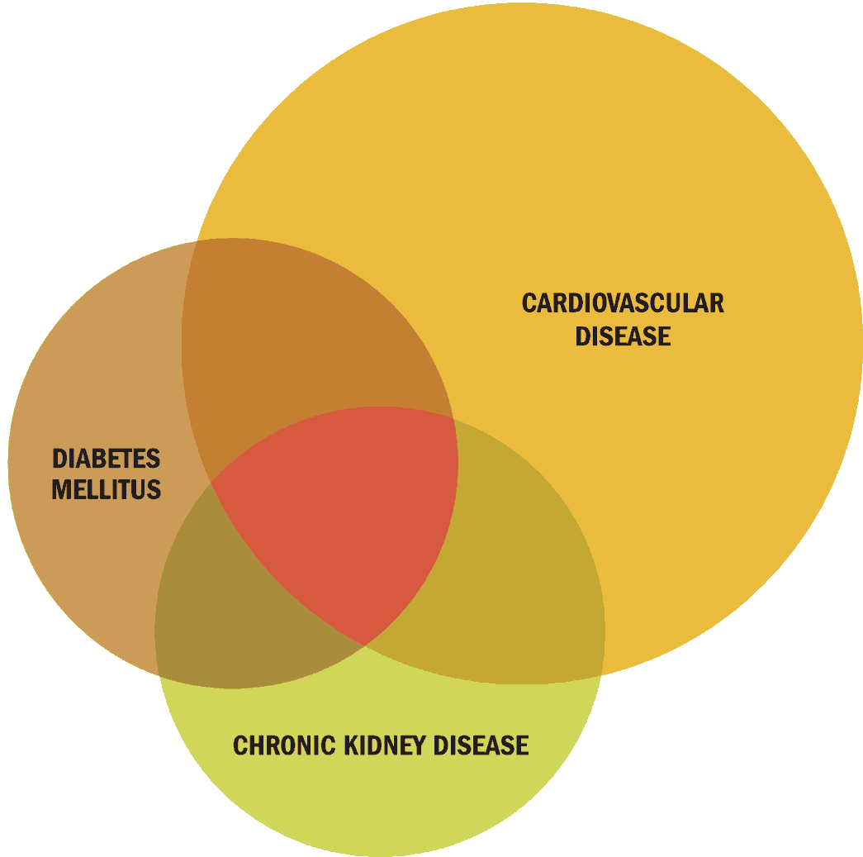
CVD and CKD
CKD – At high risk for CVD
CVD Prevalence- CKD VS NO CKD - 69.6 vs 34.7 %
Presence of CKD often complicates CVD treatment/ prognosis.
Atherosclerotic heart disease -most frequent CVD linked to CKD. Prevalence >40 %
CKD – more cardiovascular procedures.
Increased Hospitalizations- CV + Infectious causes
Notes:
People with CKD are at high risk for CVD, and the presence of CKD often complicates CVD treatment and prognosis.
The prevalence of CVD is 69.6 percent among persons ages 66 and older who have CKD, compared to 34.7 percent among those who do not have CKD.
Atherosclerotic heart disease is the most frequent CVD linked to CKD; its prevalence is more than 40 percent among people ages 66 and older.
The percentage of people who undergo cardiovascular procedures is higher among those with CKD than among those without CKD.

Slide 16
BURDEN OF CKD
Individual or societal costs
Attributable or excess mortality
Years of life lost (YLL)
Disability-adjusted life years (DALYs).
Notes:
may be examined in several ways, including individual or societal costs, attributable or excess mortality, years of life lost (YLL), and disability-adjusted life years (DALYs).

Slide 17
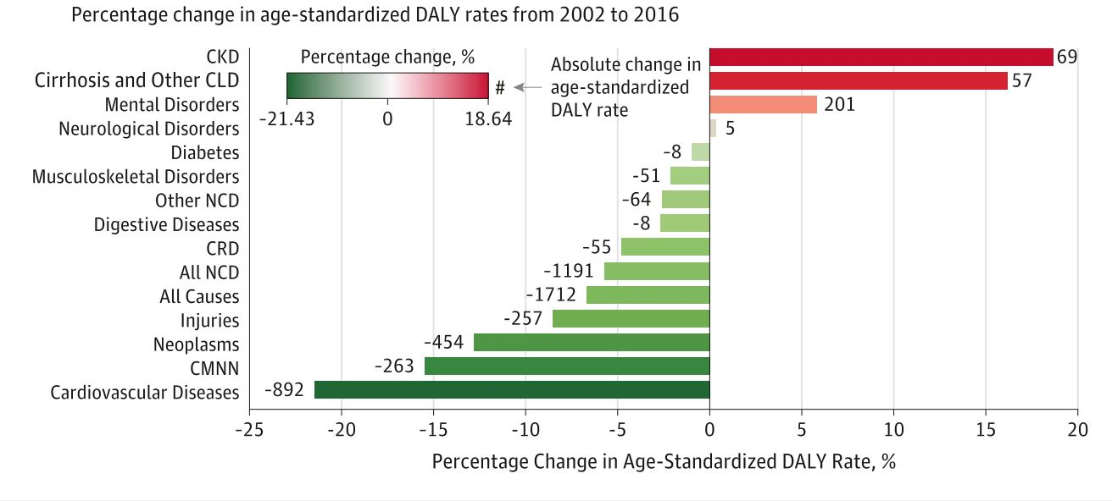
Global Burden of Disease Study- US DATA
DALYs - YLLs plus years of poor health or disability.
DALYs attributed to CKD within the United States increased by 52.6% from 2002 to 2016- exceeded for any chronic disorder during this period
Notes:
The burden of CKD may be examined in several ways, including individual or societal costs, attributable or excess mortality, years of life lost (YLL), and disability-adjusted life years (DALYs).
DALYs include YLLs plus years of poor health or disability.
An analysis of the Global Burden of Disease Study (4) showed that the DALYs attributed to CKD within the United States increased by 52.6% from 2002 to 2016. This increase exceeded the DALY increase from any chronic disorder in the United States during this period.

Slide 18
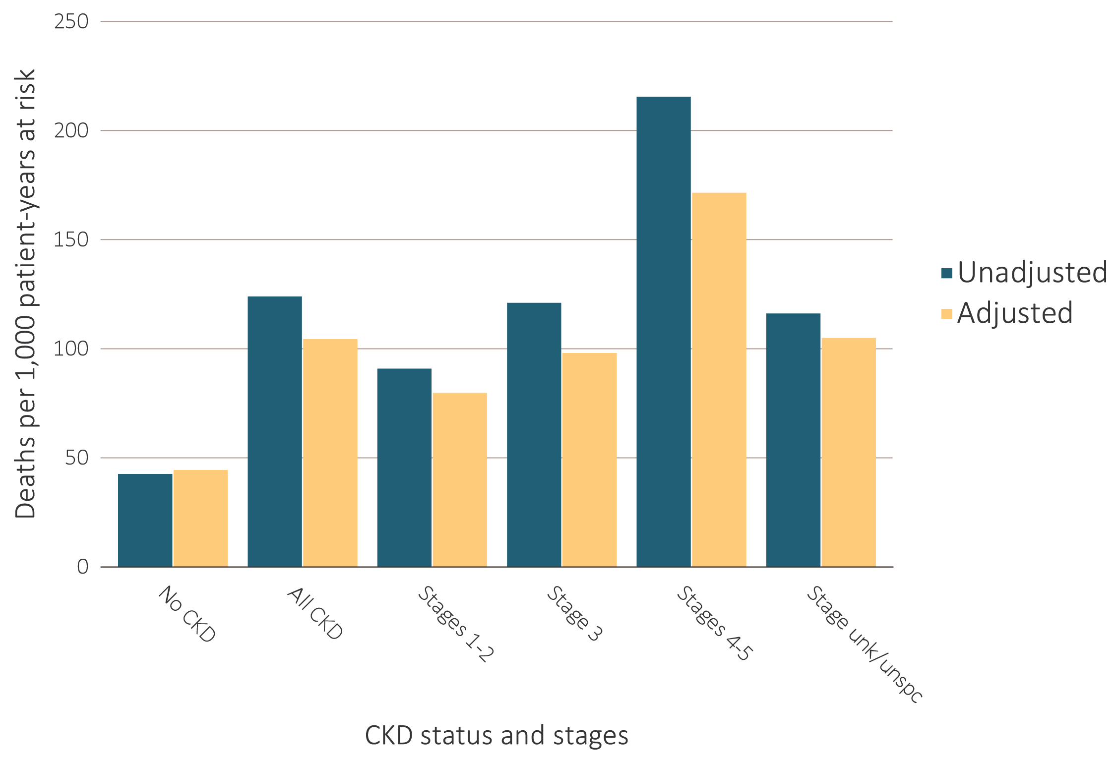
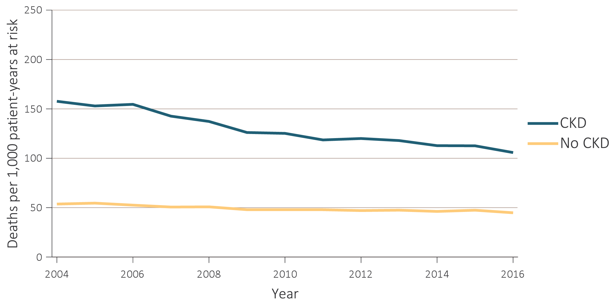
Adjusted Mortality rates - Medicare patients 2004-2016
CKD VS No CKD
CKD status
Notes:
When adjusted for sex, age, and race, the rate remained more than double the 43.1 per 1,000 patient-years of those without CKD. Mortality rates increased with CKD severity, but the gap has narrowed between CKD and non-CKD patients from 2004-2016

Slide 19
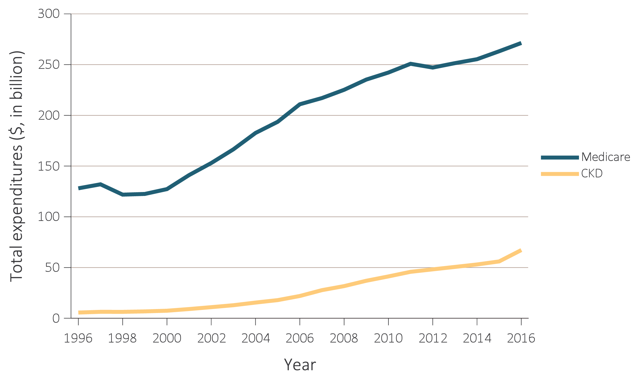
MEDICARE GEN POPULATION VS CKD, 1996-2016
CKD -12.5% population > $79 billion in 2016.
70 % spending in pt with CKD– DM + CHF/ both.
TOTAL MEDICARE CKD + ESRD - $114 BILLION, 23% OF SPENDING
Notes:
Medicare spending for all beneficiaries who had CKD (12.5% of total) exceeded $79 billion in 2016, an increase of 23% from 2015 (Tables 7.1 and 7.3). When adding an extra $35 billion for end-stage renal disease (ESRD) costs (see Volume 2, Chapter 9: Healthcare Expenditures for Persons with ESRD, Figure 9.2), total Medicare spending on both CKD and ESRD was over $114 billion, representing 23% of total Medicare fee-for-service (FFS) spending
70 percent of Medicare spending for CKD patients ages 65 and older was incurred by those who also had diabetes, congestive heart failure, or both.
Although spending was 12.7 percent higher for African Americans than Caucasians in 2013, this represented a reduction from the 19.6 percent gap that occurred in 2010.
Spending was more than twice as high for patients with all three chronic conditions of CKD, diabetes, and congestive heart failure ($38,230) than in patients with only CKD ($15,614).

Slide 20
CKD Screening and Evaluation

Slide 21

Criteria for CKD
Abnormalities of kidney function or structure with implications for health | TIMELINE
GFR <60 mL/min/1.73 m² OR Urine ACR >30 mg/g OR Markers of kidney damage (one or more*) | >3 months
*Markers of kidney damage can include nephrotic syndrome, nephritic syndrome, tubular syndromes, urinary tract symptoms, asymptomatic urinalysis abnormalities, asymptomatic radiologic abnormalities, hypertension due to kidney disease.
GFR – Glomerular Filtration rate
ACR- Urine Albumin Creatinine ratio

Slide 22
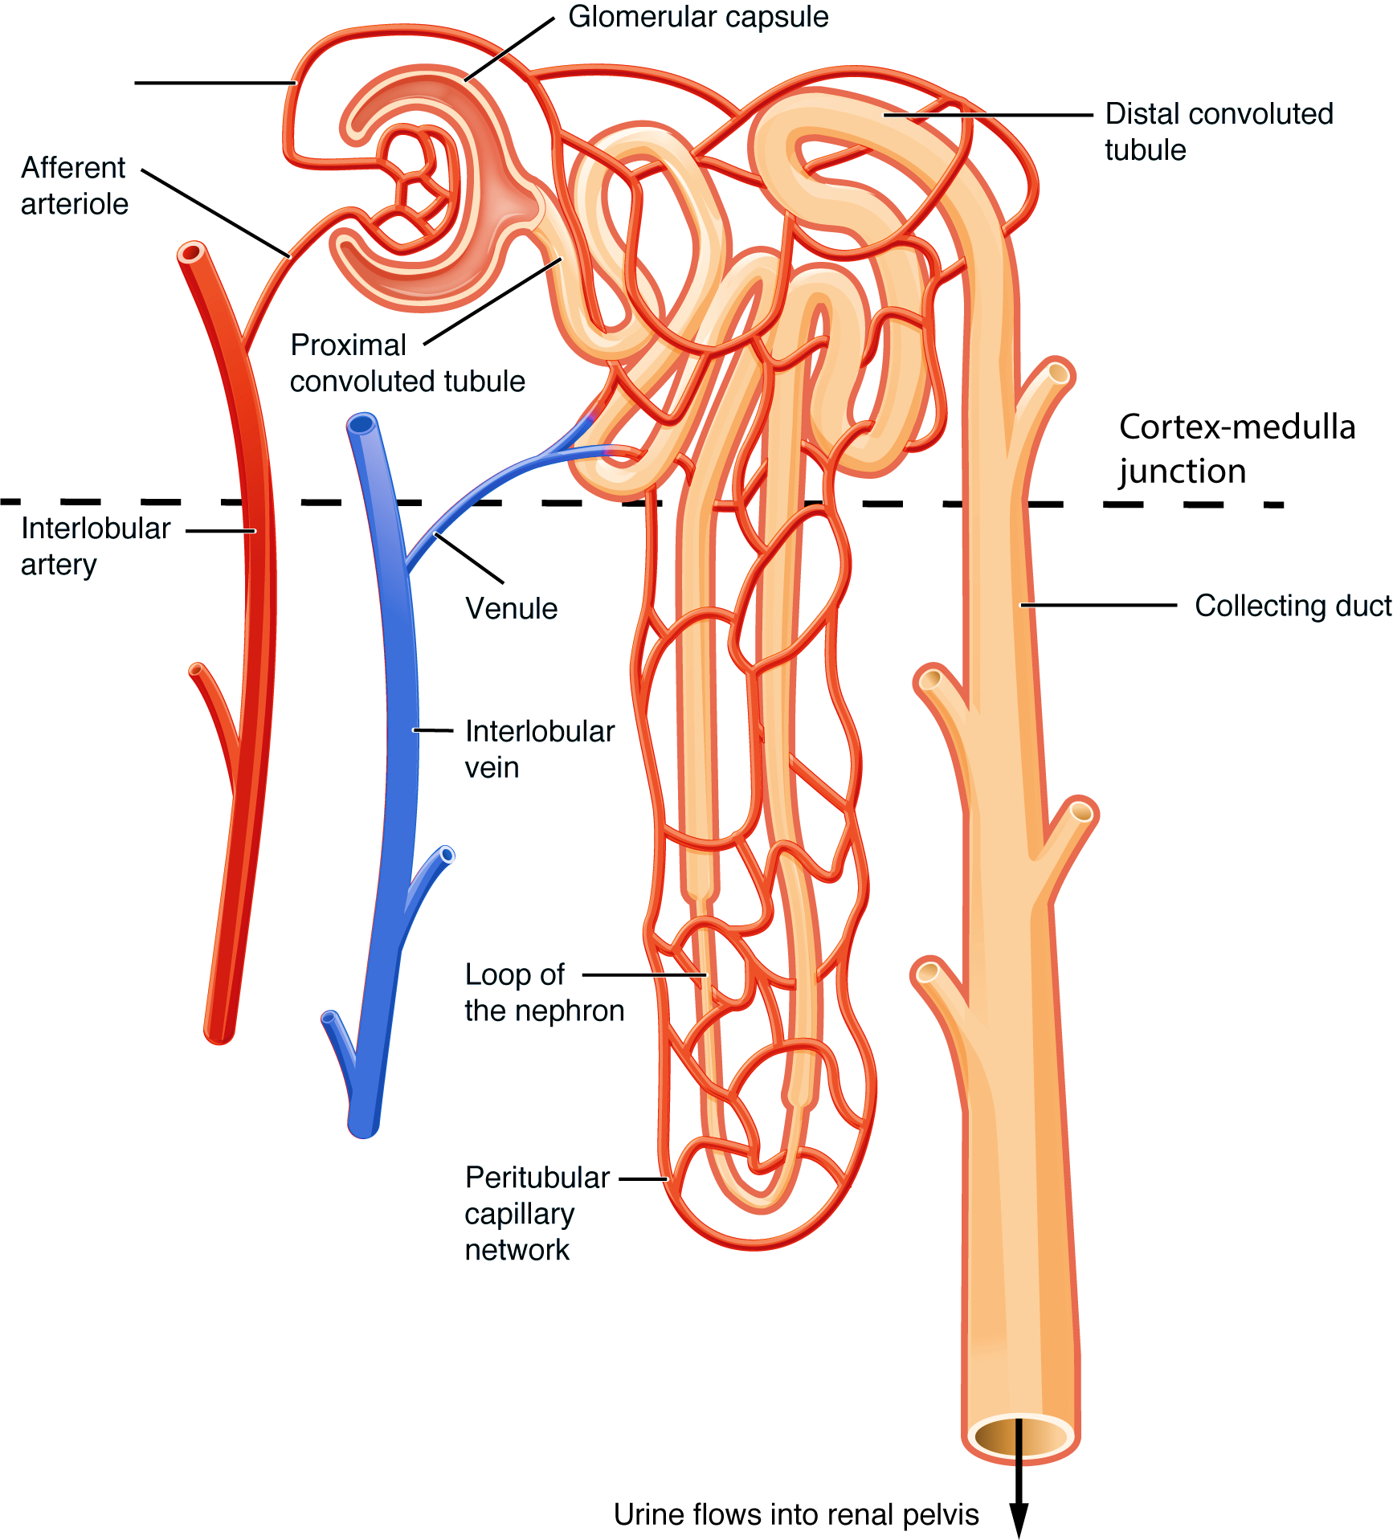
Screening Tools: Glomerular filtration rate (GFR)
GFR - Sum of the filtration rates in all of the functioning nephrons
Rough measure of the number of functioning nephrons
Kidneys filter 180 liters per day (125 mL/min) of plasma
Range- 130 and 120 mL/min/1.73 m² for men and women, respectively
Considerable variation even among normal individuals
Normal GFR - age, sex, and body size, and declines with age
Notes:
Seglomerular filtration rate (GFR) is equal to the sum of the filtration rates in all of the functioning nephrons; thus, the GFR gives a rough measure of the number of functioning nephrons. The filtering units of the kidney, the glomeruli, filter approximately 180 liters per day (125 mL/min) of plasma. The normal value for GFR depends upon age, sex, and body size, and is approximately 130 and 120 mL/min/1.73 m² for men and women, respectively, with considerable variation even among normal individualsrum creatinine alone should not be used to estimate kidney function. A rise in blood creatinine levels is observed only after significant loss of functioning nephrons.
Estimates of GFR (eGFR) is considered a better way to measure kidney function. eGFR utilizes equations that use serum creatinine levels and some or all of the following variables: gender, age, weight, and race.
Glomerular filtration rate (GFR) is considered the best overall index of kidney function. Normal GFR varies according to age, sex, and body size, and declines with age. The National Kidney Foundation recommends using the CKD-EPI Creatinine Equation (2009) to estimate GFR.
No methods to estimate GFR unless patient is in steady state. All are of limited value for patients at extremes of age, over/underweight, amputees, non black/white racial groups.
MDRD
Cockroft Gault
CKD-EPI (Preferred)
The MDRD equation was the first and most widely used eGFRcr equation with a known calibration. Recommended by NKF KDOQI 2002.
The CKD-EPI (2009) equation improves on the MDRD Study equation, particularly in reducing bias at eGFR >60 allowing for reporting across the full range of eGFR. Recommended by KDIGO 2013
Adjust for body size for most accurate eGFR with MDRD and CKD-EPI Creatinine Clearance
GFR calculators are available online at www.kidney.org/GFR.
Summary of the MDRD Study and CKD-EPI Estimating Equations
https://www.kidney.org/sites/default/files/docs/mdrd-study-and-ckd-epi-gfr-estimating-equations-summary-ta.pdf
Calculators for Health Care Professionals
http://www.kidney.org/professionals/KDOQI/gfr_calculator

Slide 23
GFR Measurement vs Estimation
Measurement of GFR - Remember Inulin clearance from Med school !!!!
Estimation-
Creatinine clearance
Estimation equations based upon serum creatinine (Cystatin C) as biomarker
Cockcroft-Gault equation
Modification of Diet in Renal Disease (MDRD) study equation **
Chronic Kidney Disease Epidemiology Collaboration (CKD-EPI) equation **
Other serum markers- blood urea nitrogen (BUN)/ serum cystatin C
Notes:
Measurement of (GFR) is complex, time consuming, and cumbersome to do in clinical practice.
classic protocol for measuring inulin clearance requires a continuous intravenous infusion, multiple blood samples, and bladder catheterization
. The abbreviated MDRD study and CKD-EPI equations are being increasingly utilized equations for Serum creatinine (eGFRcr) or cystatin C (eGFRcys)

Slide 24
Use These Equations Cautiously….
eGFRcr generally is accurate, except in situations such
  Loss of muscle mass/ Amputation
  Poor nutrition/ Chronic illness/Extremes of protein intake
  Changing serum creatinine
  Obese
  Very elderly, young
  Drug-induced inhibition of tubular function (e.g., trimethoprim).
Notes:
When eGFRcr might be inaccurate- eGFRcys – based on Serum cystatin C measurement - For dosing renotoxic drugs or drugs with renal clearance.

Slide 25
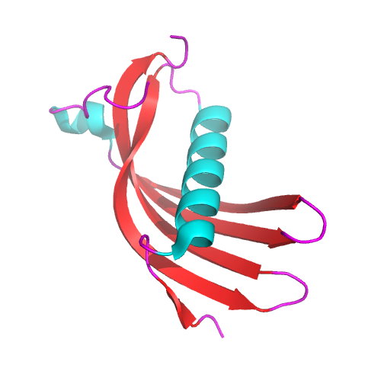
What is Cystatin C?
Member of the cystatin superfamily of cysteine protease inhibitors.
Produced by all nucleated cells- relatively constant, and not affected by changes in diet
Filtered at the glomerulus and not reabsorbed.
Cystatin C-based estimates - less influenced by muscle mass or diet than creatinine-based estimates.
Improve patient care – unknown !!
For now used only as a confirmatory test OR in combination with Serum creatinine !!

Slide 26
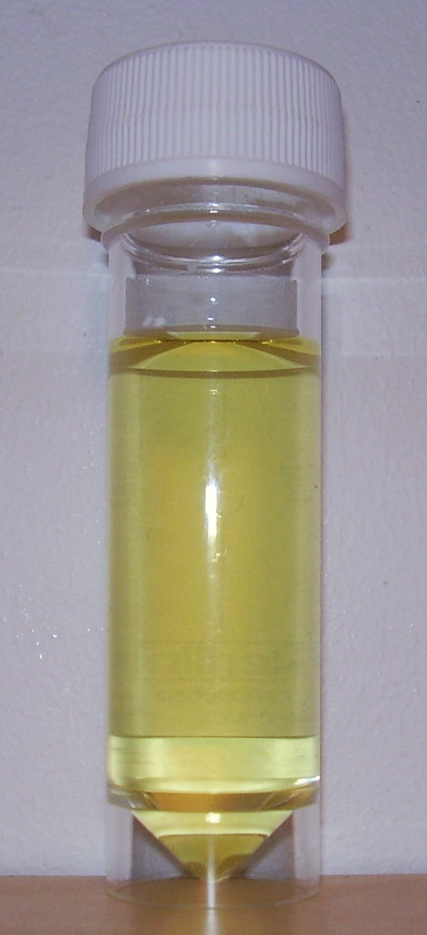
Screening Tools: Urinary albumin-to-creatinine ratio (ACR)
Spot urine for quantification of proteinuria/ Albuminuria
First morning void preferable.
24hr urine test rarely necessary.
Divide Urine Albumin concentration in mg by creatinine concentration in grams.
Creatinine Adjusts albumin levels for varying urine concentrations, which allows for more accurate results versus albumin alone.
Notes:
Creatinine assists in adjusting albumin levels for varying urine concentrations, which allows for more accurate results versus albumin alone.

Slide 27
Definitions: Albuminuria
Normal Albuminuria
  Albumin: Creatinine ratio < 30 mg/g creatinine
Moderately Increased Albuminuria
  Albumin: creatinine ratio 30-300 mg/g creatinine
  24-hour urine albumin 30-300 mg/d
Severely Increased Albuminuria
  Albumin: Creatinine ratio > 300 mg albumin/g creatinine
  24-hour urine albumin > 300 mg/d

Slide 28
NEXT STEPS…
Confirming the chronicity of damage or decreased function
  Review past labs
  Repeat testing
Staging of CKD
  Cause of disease
  Six categories of GFR (G stages)
  Three categories of albuminuria (A stages)
Notes:
the KDIGO guidelines require that the damage or decreased function be persistent for at least three months in order to make a diagnosis of CKD. Chronicity may be documented or inferred. When evidence of kidney damage or decreased function is first apparent, confirmation of chronicity can be obtained by one of the following:he purpose of CKD staging is to guide management, including stratification of risk for progression and complications of CKD. Risk stratification is used as a guide to inform appropriate treatments and the intensity of monitoring and patient education [1,4].

Slide 29
Old Classification of CKD- GFR Alone
Stage | Description | Classification by Severity | Classification by Treatment
1 | Kidney damage with normal or increased GFR | GFR ≥ 90
2 | Kidney damage with mild decrease in GFR | GFR of 60-89 | T if kidney transplant
3 | Moderate decrease in GFR | GFR of 30-59 | recipient
4 | Severe decrease in GFR | GFR of 15-29 | D if dialysis
5 | Kidney failure | GFR < 15 | D if dialysis
Note: GFR is given in mL/min/1.73² m²
National Kidney Foundation. KDOQI Clinical Practice Guidelines for Chronic Kidney Disease:
Evaluation, Classification, and Stratification. Am J Kidney Dis 2002;39(suppl 1):S1-S266
KDIGO, Kidney Disease: Increasing Global Outcomes

Slide 30
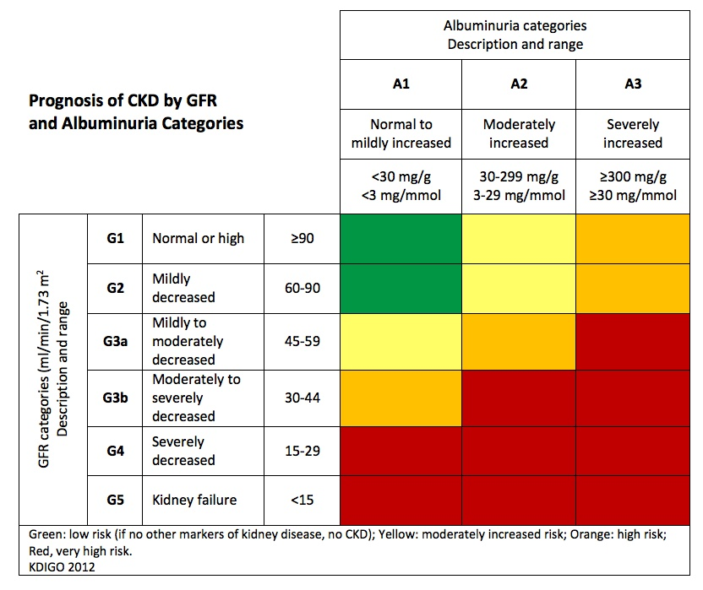
Classification of CKD Based on GFR and Albuminuria Categories: “Heat Map”
Moderate risk (yellow) – 73 %
High risk (orange) – 18 %
Very high risk (red) – 9 %
Kidney Disease: Improving Global Outcomes (KDIGO) CKD Work Group. Kidney Int Suppls. 2013;3:1-150.
Notes:
Colors: Represents the risk for progression, morbidity and mortality by color from best to worst. Green: low risk (if no other markers of kidney disease, no CKD); Yellow: moderately increased risk; Orange: high risk; Red, very high risk.
Staging system for CKD is intended to aid clinicians in the management of patients with CKD by identifying those with the most severe disease who are, therefore, at greatest risk for progression and complications.
18 separate categories with differing degrees of risk for progression to all-cause mortality, cardiovascular mortality, ESRD, CKD progression, and acute kidney injury.
The relative risk for each outcome is higher with more severe GFR and ACR stages
three broad risk categories may help clinicians decide whether or not to refer their patients to a nephrologist or specialist with expertise in caring for patients with CKD, and to develop a clinical action plan.

Slide 31
Clinical Evaluation of Patients with CKD
Depending on Stage:
Serum albumin, phosphate, calcium, iPTH, Vitamin D 25 OH levels and H/H
Renal imaging- USG- Atleast once
Depending on potential causes
  Light chain assay, serum or urine protein electrophoresis (SPEP, UPEP)
  HIV, HCV, HBV tests
  Complements, other serologies—limited role unless specific reason.

Slide 32
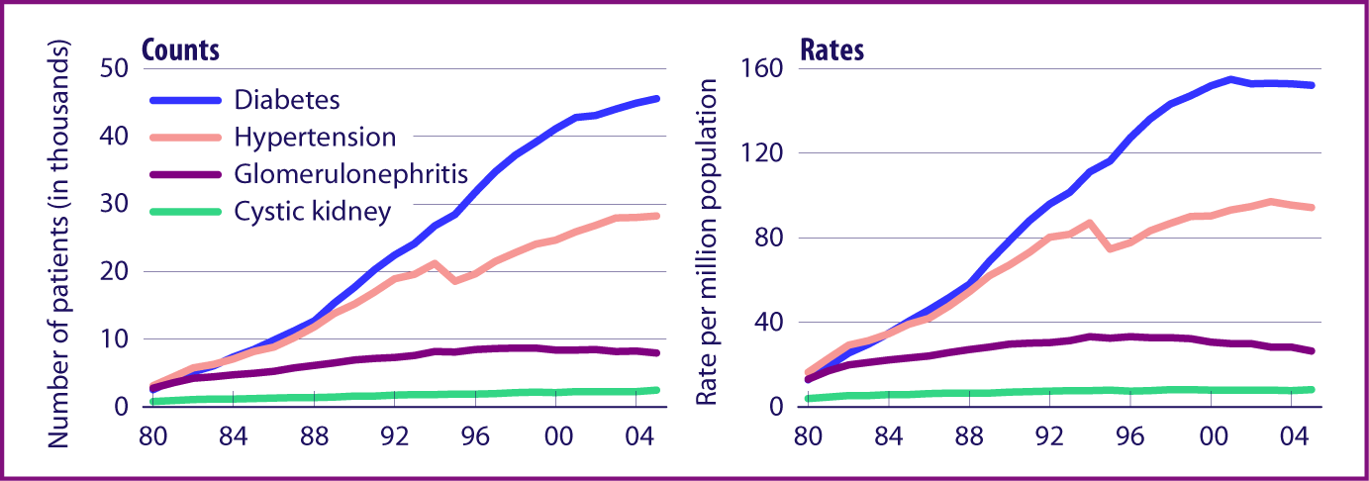
Diabetes and hypertension - leading causes of kidney failure
Incident ESRD rates, by primary diagnosis, adjusted for age, gender, & race.

Slide 33
CKD Risk Factors*
Non-Modifiable
Family history of kidney disease, diabetes, or hypertension
Age 60 or older (GFR declines normally with age)
Race/U.S. ethnic minority status
Genetics APOL – 1 gene
Modifiable
Diabetes
Hypertension
Proteinuria > 1gm
History of AKI
Childhood Hx of kidney disease – 4X increased lifetime risk of ESRD
Frequent nephrotoxic med use
Obesity- independent risk factor
Persistent heroin, cocaine, or methamphetamine use. Not Marijuana usage.

Slide 34
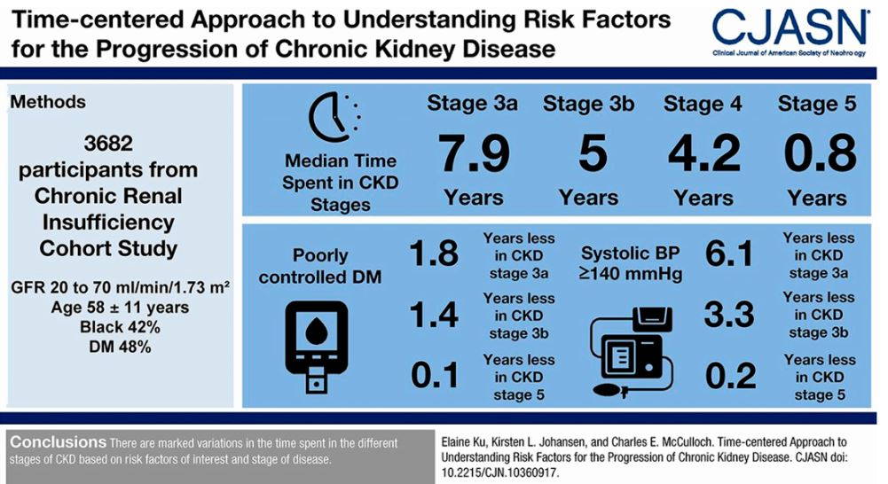

Slide 35
CKD Management

Slide 36
Goals of Care in CKD
Treatment of Reversible causes of renal failure
Preventing or slowing the progression of renal disease
Treatment of the complications of renal failure
Reducing CVD risk
Reducing infection risk
Improving patient safety - Adjusting drug doses when appropriate for the level of estimated glomerular filtration rate (eGFR)
Identification and adequate preparation for renal replacement therapy
Notes:
Decreased renal perfusion
Administration of nephrotoxic drugs
Urinary tract obstruction

Slide 37
Slowing Progression of CKD

Slide 38
CKD- Progression of Kidney Failure
Variable depending on several factors including (1) type of disease and (2) how well it is treated
GFR
100
90
80
70
60
50
40
30
20
10
Slow decline
Stage 2
Rapid decline
Moderate decline
Stage 3
Stage 4
Stage 5 (Dialysis)
0 1 2 3 4 5 6 7
Years

Slide 40
Blood Pressure and CKD Progression
Control of BP with avoidance of side-effects is important
Target BP < 130/80 - Systolic Pressure Intervention Trial (SPRINT)
With proteinuria: 1st line ACEi or ARB +/- diuretic
No proteinuria: 1st line Diuretics
  ACEi or ARB or CCA or diuretic- based on comorbid conditions.
Notes:
Fujisaki K, Tsuruya K, Nakano T, Taniguchi M, Higashi H, Katafuchi R, Kanai H, Nakayama M, Hirakata H, Kitazono T. Impact of combined losartan/hydrochlorothiazide on proteinuria in patients with chronic kidney disease and hypertension. Hypertens Res. 2014;37(11):993-998.

Slide 41
Slowing CKD Progression: ACEi or ARB
Risk/benefit should be carefully assessed in the elderly and medically fragile
Check labs after initiation
  If less than 25% SCr increase, continue and monitor
  If more than 25% SCr increase, stop ACEi/ ARB and evaluate for RAS
Continue until contraindication arises, no absolute eGFR cutoff
Better proteinuria suppression in combination with low Na diet and diuretics
Avoid volume depletion
Avoid ACEi and ARB in combination^{1,2-} Risk of adverse events (impaired kidney function, hyperkalemia)
Kunz R, et al. Ann Intern Med. 2008;148:30-48.
Mann J, et al. ONTARGET study. Lancet. 2008;372:547-553.
Notes:
Avoid combination of ACEi and ARB. Data has shown an increase in adverse events, particularly impaired kidney function and hyperkalemia.1,2
1. Kunz R, Friedrich C,Wolbers M, Mann JF. Meta-analysis: effect of monotherapy and combination therapy with inhibitors of
the renin angiotensin system on proteinuria in renal disease. Ann Intern Med. Jan 1 2008;148(1):30-48.
2. Mann JF, Schmieder RE, McQueen M, et al. Renal outcomes with telmisartan, ramipril, or both, in people at high vascular risk (the ONTARGET study): a multicentre, randomised, doubleblind, controlled trial. Lancet. Aug 16 2008;372(9638):547-553

Slide 42
Goals of Care in CKD: Glucose Control
Target HbA1c ~7.0%
Can be extended above 7.0% with comorbidities or limited life expectancy, and risk of hypoglycemia
Risk of hypoglycemia increases as kidney function becomes impaired
Declining kidney function may necessitate changes to diabetes medications and renally- cleared drugs
NKF KDOQI. Diabetes and CKD: 2012 Update.
Am J Kidney Dis. 2012 60:850-856.

Slide 43
CKD Diabetes- Metformin
Risk of Lactic acidosis – less than phenformin
Incidence as low as 0.03 cases per 1000 patient-years.
FDA METFORMIN USAGE RECOMMENDATIONS-
eGFR ≥60 mL/min/1.73 m² - no dose adjustments -Annual monitoring.
eGFR between 45 mL/min/1.73 m² and 60 mL/min/1.73 m² - Monitor every 3 to 6 months.
eGFR between 30 mL/min/1.73 m² and 45 mL/min/1.73 m²) DO NOT initiate metformin. Already on Metformin- consider a 50% dose reduction with renal function monitoring every 3 months.
Contraindication in advanced kidney disease (eGFR <30 mL/min/1.73m²).
Notes:
Metformin FDA approval 1994 based on -phenformin, which showed a greater risk of lactic acidosis associated with significant mortality.

Slide 44
CKD Diabetes
Sodium-glucose cotransporter 2 (SGLT-2) inhibitors
Reduce blood glucose by increasing urinary glucose excretion.
Canagliflozin (Invokana)
Dapagliflozin (Farxiga)
Empagliflozin (Jardiance)

Slide 45
Sodium-glucose cotransporter 2 (SGLT-2) inhibitors….
CREDENCE- Canagliflozin vs placebo
Diabetic (estimated or measured urine albumin excretion >300 mg per day) and an estimated GFR (eGFR) ≥30 mL/min per 1.73 m².
4401 diabetic patients with an eGFR between 30 and 89 and UACR >300 mg/g (median, 927 mg/g) despite taking an ACE inhibitor or ARB for 2.6 years,
Reduced the incidence of ESRD, doubling of serum creatinine, hospitalization for heart failure, cardiovascular death, and all-cause mortality (cardiovascular death and all-cause mortality were not statistically significant)
In patients with type 2 diabetes who have severely increased albuminuria (UACR ≥300 mg per day) despite angiotensin inhibition- Consider treatment with SGLT2 inhibitor

Slide 46
Sodium-glucose cotransporter 2 (SGLT-2) inhibitors….
Limitations- Not be used for the treatment of hyperglycemia in patients with:
● Type 1 diabetes
● Type 2 diabetes and eGFR <45 mL/min/1.73 m²
● Frequent UTI or genitourinary yeast infections.
● Low BMD and high risk for fracture and falls.
● Foot ulceration (eg, neuropathy, foot deformity, vascular disease, and/or history of previous foot ulceration) due to risk of amputations.
● Factors predisposing to DKA (eg, ketosis-prone type 2 diabetes, pancreatic insufficiency, drug or alcohol addiction)- risk of non hyperglycemic Ketosis

Slide 47
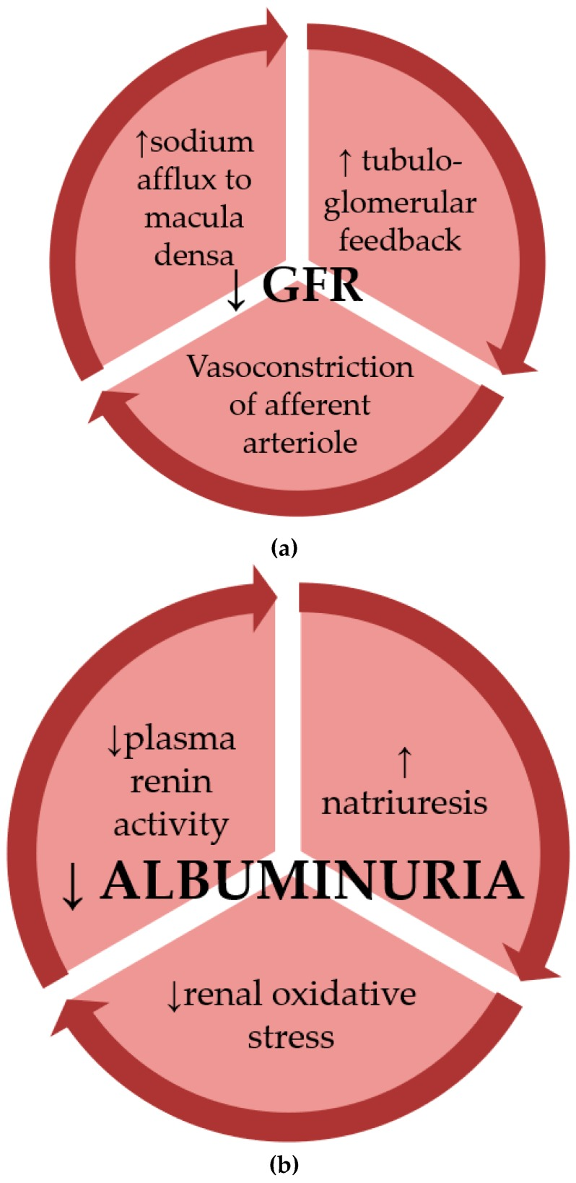
CKD Diabetes….
Glucagon-like peptide-1 GLP 1 receptor agonists showing promise —
Liraglutide (Victoza )
  Reduced the incidence of a composite renal endpoint (consisting of new onset of albuminuria >300 mg/day, doubling of serum creatinine, end-stage renal disease, or renal death) in a large trial of patients with type 2 diabetes
Dulaglutide (Trulicity )
  Slowed kidney disease progression and prevented worsening of albuminuria in trials of diabetic patients with and without chronic kidney disease

Slide 48
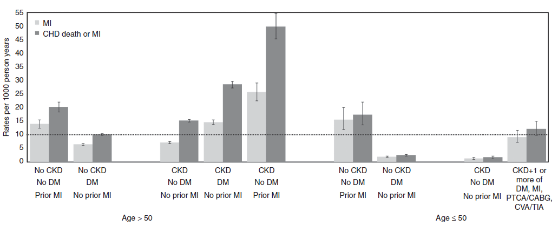
10-Year Coronary Risk Based on Age and Other Patient Characteristics
Future 10-year coronary risk based on various patient characteristics. Data are unadjusted rates from 1,268,029 participants in the Alberta Kidney Disease cohort.^{1,2}
CABG, coronary artery bypass grafting; CHD, coronary heart disease; CKD, chronic kidney disease; CVA, cerebrovascular accident; DM, diabetes mellitus; MI, myocardial infarction; PTCA, percutaneous transluminal coronary angioplasty; TIA, transient ischemic attack.
1) Kidney Disease: Improving Global Outcomes (KDIGO) Lipid Work Group. Kidney Int Suppl. 2013;3:259-305.
2) Hemmelgarn BR, et al. Overview of the alberta kidney disease network. BMC Nephrol. 2009:30:10.

Slide 49
Lipid Disorders in CKD
  Hypertriglyceridemia - Primary lipid abnormality
  All CKD patients undergo lipid panel. Recheck annually.
  MANAGEMENT- LDL-C reduction similar in patients with nondialysis CKD and in patients without CKD
  Secondary prevention – established atherosclerotic cardiovascular disease - Maximally tolerated statin therapy
  Primary prevention - predicted 10-year absolute risk of having a major cardiovascular event is 7.5 to 10 percent or greater
  Dietary modification.
  Typically fibrates not recommended due to side effect profile with concomitant statin usage.
Notes:
KDIGO Lipid Guidelines FIRE and FORGET approach: Treat CKD patients (Non dialysis) with statins or Statin/ exterminate combinations without the need for follow up blood tests.
http://kdigo.org/home/2013/11/04/kdigo-announces-publication-of-guideline-on-lipid-management/

Slide 50
Modification of Other CVD Risk Factors in CKD
Smoking cessation
Exercise
Weight reduction to optimal targets- Bariatric surgery - no increased risk of CKD/ ESRD
Aspirin for secondary prevention. Primary prevention- based on patient's overall risk for CHD

Slide 51
Complications of Kidney Failure Start in Stage 3 and Progress
Fluid overload
Water overload
Acid Base Imbalance
Acidic Blood
Electrolyte Abnormalities
Malnutrition
Kidney Failure
Bone Disease
Brittle bones
And fractures
Hypertension
Cardiac Disease
Vascular Disease
Anemia/blood loss
Decrease production
Of red blood cells
Notes:
Many CKD complications, such as anemia and CKD-MBD, are typically managed by the nephrologist, particularly in the cases of advanced CKD and kidney failure. It is important to check these if and when referring, but in many cases managing them can be more the role of the nephrologist.

Slide 52
CKD Complications- Anemia
  Goal Hb 10 – 11 gm %
  Initiate iron therapy if TSAT ≤ 30% and ferritin ≤ 500 ng/mL (IV iron for dialysis, Oral for non-dialysis CKD)
  Individualize erythropoiesis stimulating agent (ESA) therapy: Start ESA if Hb <10 g/dl, and maintain Hb <11.5 g/dl.
  Appropriate iron supplementation is needed for ESA to be effective

Slide 53
CKD-MBD Testing
CKD Stage | Calcium, Phosphorus | PTH | 25(OH)D
Stage 3 | Every 6-12 months | Once then based on CKD progression | Once, then based on level and treatments
Stage 4 | Every 3-6 months | Every 6-12 months
Stage 5 | Every 1-3 months | Every 3-6 months
Use CKD progression, presence or absence of abnormalities, treatment response and side effects to guide testing frequency.

Slide 54
CKD-MBD
Treat with D3 as indicated to achieve normal serum levels
2000 IU po qd is cheaper and better absorbed than 50,000 IU monthly dose.
Limit phosphorus in diet, with emphasis on decreasing packaged products - Refer to renal RD
May need phosphate binders

Slide 55
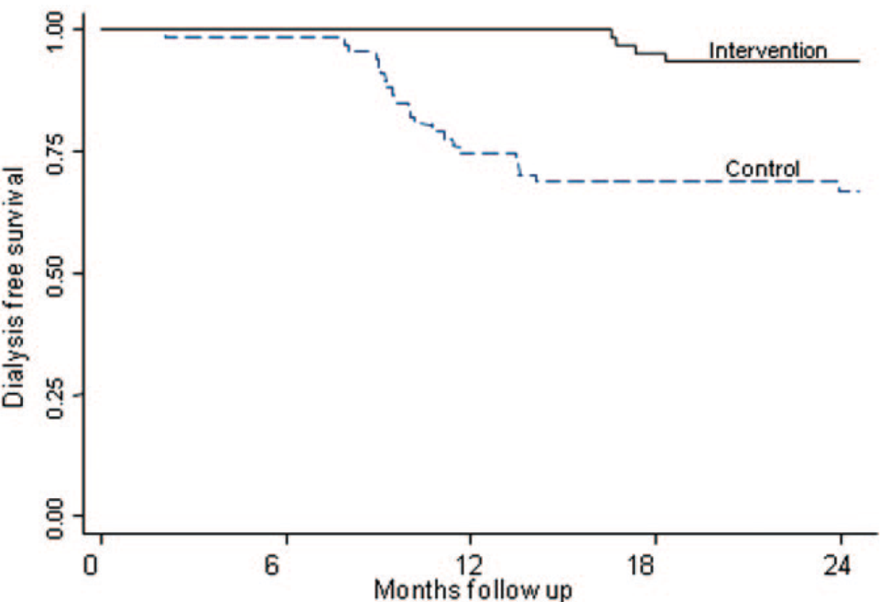
Metabolic Acidosis
GFR < 25-30 ml/min
  More severe with higher protein intake
May contribute to bone disease, protein catabolism, and progression of CKD
Correction of metabolic acidosis may slow CKD progression and improve patients functional status^{1,2}
Adults with CKD (eGFR 15-30 ml/min/1.73m²) with bicarbonate 16-20 mmol/L; treated with sodium bicarbonate for 2 years to normalize serum bicarbonate concentration²
Mahajan, et al. Kidney Int. 2010;78:303-309.
de Brito-Ashurst I, et al. J Am Soc Nephrol. 2009;20:2075-2084.
Notes:
Correction of metabolic acidosis may slow CKD progression and improve patients functional status^{1,2}
1) Mahajan A, Simoni J, Sheather S, Broglio K, Rajab M, Wesson D. Daily oral sodium bicarbonate preserves glomerular filtration rate by slowing its decline in early hypertensive nephropathy. Kdney Int. 2010;78:303-309.
2) de Brito-Ashurst I, Varagunam M, Raftery M, Yaqoob M. Bicarbonate supplementation slows progression of CKD and improves nutritional status. J Am Soc Nephrol. 2009;20:2075-2084.

Slide 56
Metabolic Acidosis
Maintain serum bicarbonate > 22 mmol/L
  Start with 0.5-1 mEq/kg per day
  Sodium bicarbonate tablets
    325mg, 650 mg tablets; 1 g = 12 mEq
  Sodium citrate solution
    1 mEq/ml
    Avoid if on aluminum phosphate binders
  Baking soda
    54 mmol/level tsp
Notes:
Correction of metabolic acidosis may slow CKD progression and improve patients functional status^{1,2}
1) Mahajan A, Simoni J, Sheather S, Broglio K, Rajab M, Wesson D. Daily oral sodium bicarbonate preserves glomerular filtration rate by slowing its decline in early hypertensive nephropathy. Kdney Int. 2010;78:303-309.
2) de Brito-Ashurst I, Varagunam M, Raftery M, Yaqoob M. Bicarbonate supplementation slows progression of CKD and improves nutritional status. J Am Soc Nephrol. 2009;20:2075-2084.

Slide 57
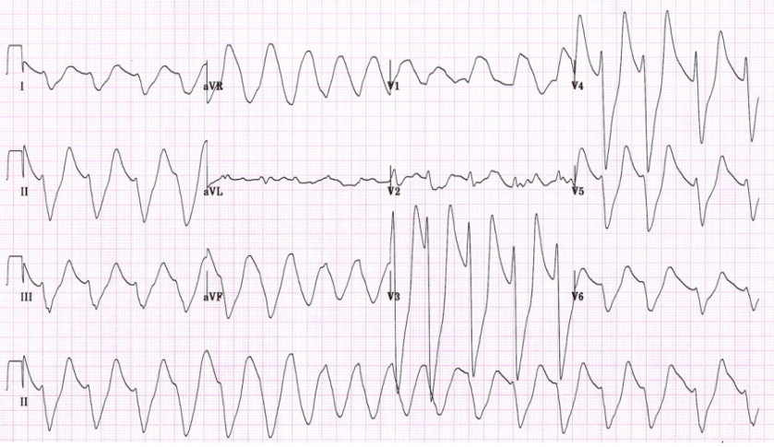
Hyperkalemia
First try reduction of dietary potassium
Stop NSAIDs, COX-2 inhibitors
Stop potassium sparing diuretics
  Aldactone
Stop or reduce beta blockers
Stop or reduce ACEi/ARBs
Avoid salt substitutes that contain potassium

Slide 58
Chronic Management of Hyperkalemia
Loop or thiazide diuretics
Laxatives
  As effective as cation exchange resins in sorbitol
  Those that induce secretory diarrhea may be more effective (e.g. bisacodyl)
  Diphenolic laxatives may stimulate colonic K+ secretion
Cation exchange resins
  Sodium polystyrene sulfonate (Kayexlate)- Mechanism Theoretical: Bound Na+ exchanged for K+ in colonic/ rectal lumen
  Patiromer - Veltassa
  Zirconium cyclosilicate – Lokelma

Slide 59
Risk Factors for Infection in People with CKD
Advanced age
High burden of coexisting illnesses (e.g., diabetes)
Hypoalbuminuria
Immunosuppressive therapy
Nephrotic syndrome
Uremia
Anemia and malnutrition
High prevalence of functional disabilities
Kidney Disease: Improving Global Outcomes (KDIGO) CKD Work Group. Kidney Int Suppls. 2013;3:1-150.

Slide 60
Vaccination in CKD
Annual influenza vaccine for all adults with CKD, unless contraindicated.
Polyvalent pneumococcal vaccine when eGFR < 30 ml/min/1.73m² and at high risk of pneumococcal infection (e.g., nephrotic syndrome, diabetes, receiving immunosuppression), unless contraindicated. Offer revaccination within 5 years.
Hepatitis B immunization when GFR < 30 ml/min/1.73 m². Confirm response with appropriate serological testing.
Use of a live vaccine should consider the patient’s immune status (e.g., immunosuppression).
Kidney Disease: Improving Global Outcomes (KDIGO) CKD Work Group. Kidney Int Suppls. 2013;3:1-150.

Slide 61
Nutrition
Optimal diet in CKD depends on
eGFR
Type of kidney disease ie, proteinuric or nonproteinuric
Presence of other comorbidities such as hypertension or heart failure
Most CKD patients- Dietary Approaches to Stop Hypertension (DASH) diet, consisting of fruits, vegetables, legumes, fish, poultry, and whole grains.
A diet rich in protein from plant sources may be beneficial

Slide 62
A Balanced Approach to Nutrition in CKD:
Macronutrient Composition and Mineral Content*
Adapted from DASH (dietary approaches to stop hypertension) diet.
*Adjust so total calories from protein, fat, and carbohydrate are 100%. Emphasize such whole-food sources as fresh vegetables, whole grains, nuts, legumes, low-fat or nonfat dairy products, canola oil, olive oil, cold-water fish, and poultry.
*(CKD Stages 1-4)
NKF KDOQI. Am J Kidney Dis. 2007;49(suppl 2):S1-S179.

Slide 63
Nutrition- Fluids !!!
Coffee consumption - possibly associated with a reduced risk of CKD - OK !!! Due to Chlorogenic acid, a dietary polyphenol- antioxidant/ anti-inflammatory properties
Sugar-Sweetened Beverages – “higher consumption of soda, sweetened fruit drinks, and water was correlated with significantly increased odds of incident CKD after adjustment for confounding variables”- NO !!
Diet soda -“Drinking 5–7 glasses per week was associated with a 1.33-fold increased risk of ESRD (95% CI, 1.01 to 1.75) and drinking >7 glasses per week was associated with a 1.83-fold higher risk (95% CI, 1.01 to 2.52)” NO NO !!!
Water intake - ?? – No change in rate of CKD decline with 2.0 vs 2.8 L of water intake. Recommend atleast 2 lt. YES YES !!!

Slide 64
Malnutrition and CKD
Malnutrition or protein energy wasting (PEW) - common in CKD- poor patient outcomes.
Malnutrition in CKD begins as early as stages 3 and 4. Risk increases with progression of the disease.
Preventing PEW or malnutrition may require clinical interventions to assess nutritional status, individualize strategies for prevention and treatment, provide patient instruction, and promote patient adherence.
A specialty-trained RD referral very helpful.
NKF KDOQI. Am J Kidney Dis. 2000;35(suppl 2):S1-S3.
NKF KDOQI. Am J Kidney Dis. 2007;49(suppl 2):S1-S179.

Slide 65
CKD Patient Safety Issues
Diagnostic tests
  Iodinated contrast media: AKI
  Gadolinium-based contrast: NSF
  Sodium Phosphate bowel preparations: AKI, CKD
CVD
  Missed diagnosis
  Improper management
Fluid management
  Hypotension
  AKI
  CHF exacerbation
AKI = acute kidney injury; CHF = congestive heart failure; NSF = nephrogenic systemic fibrosis.
Fink JC, Brown J, Hsu, VD, et al. Am J Kidney Dis 2009;53:681-668..
Notes:
Sequalea of the disease that are improperly managed to consequences of misguided therapeutic interventuions
Fink
65

Slide 66
Key Points on Medications in CKD
CKD patients at high risk for drug-related adverse events
Several classes of drugs renally eliminated
Consider kidney function and current eGFR (not just SCr) when prescribing meds
Minimize pill burden as much as possible
Remind CKD patients to avoid NSAIDs
No Dual RAAS blockade
Any med with >30% renal clearance probably needs dose adjustment for CKD
No bisphosphonates for eGFR <30
Avoid GAD for eGFR <30

Slide 67
Common Medications Requiring Dose
Reduction in CKD
Renally cleared beta blockers
  Atenolol, bisoprolol, nadolol
Digoxin
Statins
  Lovastatin, pravastatin, simvastatin. Fluvastatin, rosuvastatin
Antimicrobials
  Antifungals, aminoglycosides, Bactrim, Macrobid
Enoxaparin/ NOAC- Dabigatran/ Rivaroxiban
Methotrexate
Proton pump inhibitors- OK in the absence of strong evidence of kidney adverse effect
Allopurinol/Colchicine
Gabapentin
  CKD 4- Max dose 300mg qd
  CKD 5- Max dose 300mg qod
Reglan
  Reduce 50% for eGFR< 40
  Can cause irreversible EPS with chronic use
Narcotics
  Methadone and fentanyl best for ESRD patients
    Lowest risk of toxic metabolites

Slide 68
Co-Management, Patient Safety, and Nephrology Specialist Referral

Slide 69
Who Should be Involved in the
Patient Safety Approach to CKD?
Kidney
damage and normal or ↑ GFR
Kidney
damage and
mild ↓
GFR
Moderate
↓ GFR
Severe
↓ GFR
Kidney
failure
Stage 1 Stage 2 Stage 3 Stage 4 Stage 5
GFR 90 60 30 15
Nephrologist
Primary Care Practitioner
Consult

Slide 70
Indications for Referral to Nephrology
Acute kidney injury or abrupt sustained fall in GFR
GFR <30 ml/min/1.73m² (GFR categories G4-G5)
Persistent albuminuria (ACR > 300 mg/g)*
Atypical Progression of CKD**
Urinary red cell casts, RBC more than 20 per HPF sustained and not readily explained
Hypertension refractory to treatment with 4 or more antihypertensive agents
Persistent abnormalities of electrolytes- K/ Cal/ Na issues
Recurrent or extensive nephrolithiasis
Hereditary kidney disease
*Significant albuminuria is defined as ACR ≥300 mg/g (≥30 mg/mmol) or AER ≥300 mg/24 hours, approximately
equivalent to PCR ≥500 mg/g (≥50 mg/mmol) or PER ≥500 mg/24 hours
**Progression of CKD is defined as one or more of the following: 1) A decline in GFR category accompanied by a 25%
or greater drop in eGFR from baseline; and/or 2) rapid progression of CKD defined as a sustained decline in eGFR of more than 5ml/min/1.73m²/year. KDOQI US Commentary on the 2012 KDIGO Evaluation and Management of CKD
Notes:
Late nephrology referral before the onset of chronic kidney failure remains common. U.S. data from 2011 reveal 42.1% of new dialysis starts had no prior nephrology care.*
*USRDS 2013 Annual Data Report
www.usrds.org

Slide 71
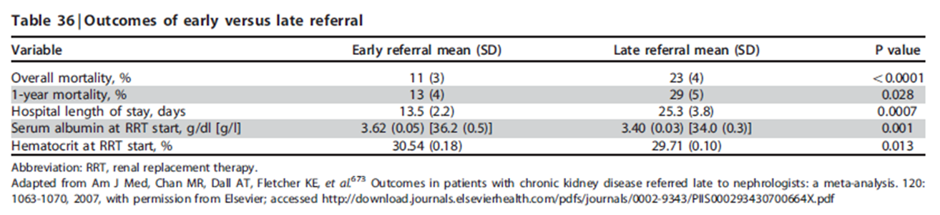
Observational Studies of Early vs. Late
Nephrology Consultation
Chan M, et al. Am J Med. 2007;120:1063-1070. KDIGO CKD Work Group. Kidney Int Suppls. 2013;3:1-150.
Notes:
Overall there are more than 50 studies in the published literature and a meta-analysis of 22 of these studies from 10 different countries serves to underline some of the key messages (Table), giving an indication of the size of the differences in mortality and hospital length of stay and also highlighting the significantly lower serum albumin level in late referred patients.1,2
1. Kidney Disease: Improving Global Outcomes (KDIGO) CKD Work Group. Kidney Int Suppls. 2013;3:1-150.
2. Chan MR, Dall AT, Fletcher KE et al. Outcomes in patients with chronic kidney disease referred late to nephrologists: a meta-analysis. Am J Med. 2007; 120: 1063-1070.
http://download.journals.elsevierhealth.com/pdfs/journals/0002-9343/PIIS000293430700664X.pdf

Slide 72
TREATMENT OPTIONS

Slide 73
“Circle of Life”
Treatment Options for Renal Replacement Therapy
ESRD
Palliative Care
Hemodialysis
Peritoneal Dialysis
Kidney Transplant
Notes:
There are essentially three options to a patient facing ESRD:
1- Dialysis
2- Transplantation, which has been clearly shown to be the best treatment option
3- or no renal replacement therapy leading to a certain death over time (an average of 10 to 90 days).
The relationship between the different renal replacement options is illustrated in this figure. Patients can start either PD or HD and switch to either modalities then receive a kidney transplant or they can also receive a pre-emptive kidney transplant.

Slide 74
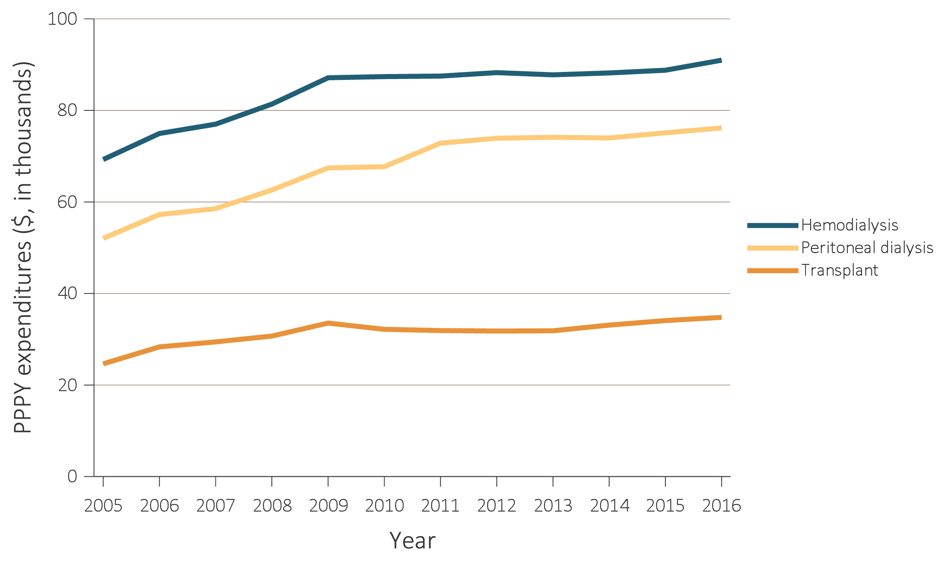
TOTAL MEDICARE ESRD EXPENDITURES BY MODALITY 2004-2016
Notes:
Medicare program for the elderly was enacted in 1965. Seven years later, in 1972, Medicare eligibility was extended both to disabled persons aged 18 to 64 and to persons with irreversible kidney failure who required dialysis or transplantation. When Medicare eligibility was first extended to beneficiaries with ESRD, only about 10,000 individuals were receiving dialysis (Rettig, 2011). By 2016, this patient group grew to 511,270. Even though the ESRD population remains at less than 1% of the total Medicare population, it has accounted for about 7% of Medicare fee-for-service spending in recent years (Figure 9.2).

Slide 75
Executive Order on Advancing American Kidney Health July 2019
Principal Goals
Reduce the number of Americans developing ESRD by 25% by 2030
Double the number of organs available for transplant by 2030
80% of new ESRD patients in 2025 will either start at home or start with a transplant
Includes New Payment Models for both ESRD and CKD care

Slide 76
Take Home Points
Diagnose and risk stratify CKD patients using appropriate screening tools- eGFR and UACR !!
Aggressive control of HTN/ DM2 with appropriate meds
Help your patient adjust medications
Modify diet
Partner and refer to specialist when appropriate

Slide 77

Thank You

Slide 78

Questions

Slide 79
Goals of Care in CKD
Raise GFR | None
Reducing albuminuria | Lower blood pressure goal, angiotensin-converting enzyme inhibitors, or angiotensin receptor blockers Slowing kidney disease progression Lower blood pressure goal, angiotensin-converting enzyme inhibitors, or angiotensin receptor blockers, if proteinuria
Preventing and treating complications | Erythropoiesis-stimulating agents, supplemental iron, phosphate binders, vitamin D analogs, calcimimetics
Reducing infection risk | Immunizations for influenza, pneumonia, and hepatitis B
Improving patient safety | Appropriate dose reduction for drugs cleared by the kidney; avoiding unnecessary use of nephrotoxic agents (nonsteroidal anti-inflammatory drugs, intravenous contrast, phosphate bowel preparations)
Reducing CVD risk | Achieving blood pressure goals, more frequent monitoring of kidney function and serum electrolytes, avoidance of statins and fibrates in combination, choice of agents for type 2 diabetes

