Slide 1

Cerner Update
Memorial Hospital of South Bend
Beacon Health System
Grand Rounds
Scott Eshowsky, MD
CMIO, Beacon Health System
May 20, 2020

Slide 2
Learning Objectives:
Recognize Health IT industry trends & how Beacon is attempting to implement tools to ease the burden of EHR-user frustrations
Prepare to transition from hospital dictation/transcription services to electronic documentation
Employ simple Tips & Tricks with the technology to reduce frustrations and increase efficiency

Slide 3
Disclosures:
I have no financial interests, ownerships, or obligations to any Healthcare or Healthcare IT companies.
Personal Disclosure:
I STILL believe in the potential of the EHR to make our lives better and to help us be better doctors.
But fully recognize the design, functionality and our use of the EHR has yet to reach that potential.

Slide 4
Topic NOT covered today:
Clinical Decision Support
for
Advanced Imaging
Please see BEHS Med Ed website for
On-Demand Recording of
EGH’s May 6th Grand Rounds.

Slide 5
Current Trends in Health IT
Voice Recognition
Mobile Applications
Artificial Intelligence
Machine Learning

Slide 6
Current Trends in Health IT
In order to take advantage of these advancements…
…we need to be sure to stay up to date and use the tools available.
This means breaking old habits.

Slide 7
A Lesson Re-Learned From COVID-19
Adaptability is the key the survivial.
What tools we use—and HOW we use them is our KEY to being adaptable.

Slide 8
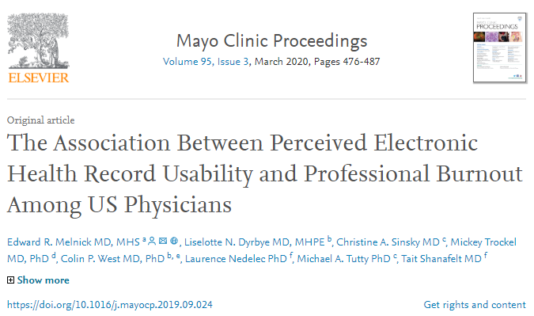
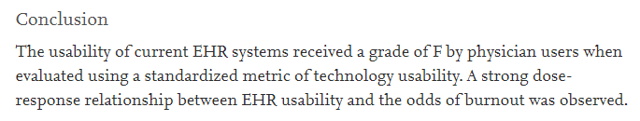
https://www.sciencedirect.com/science/article/pii/S0025619619308365
Notes:
I take this issue very seriously. I still gain great satisfaction and solace in the camaraderie I have with physicians in our community. And I don’t take for granted the platform or responsibility I have in order to realize the potential. Much of my time – and lost sleep – is dedicated to balancing and wrestling with the pressures of our payers, law-makers and policy-writers with the misery for providers that often is generated by maintaining compliance.

Slide 9
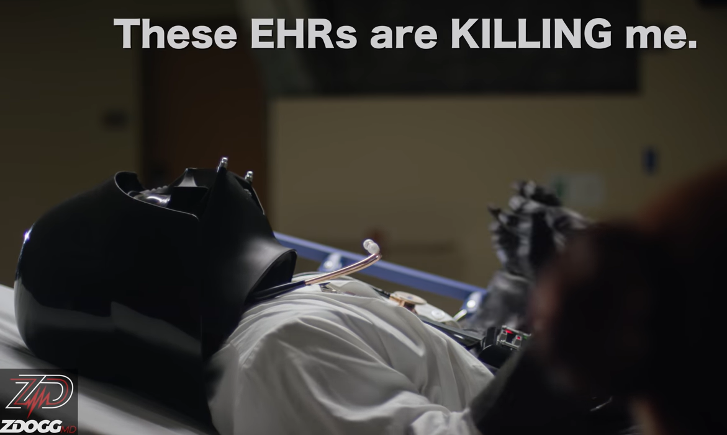
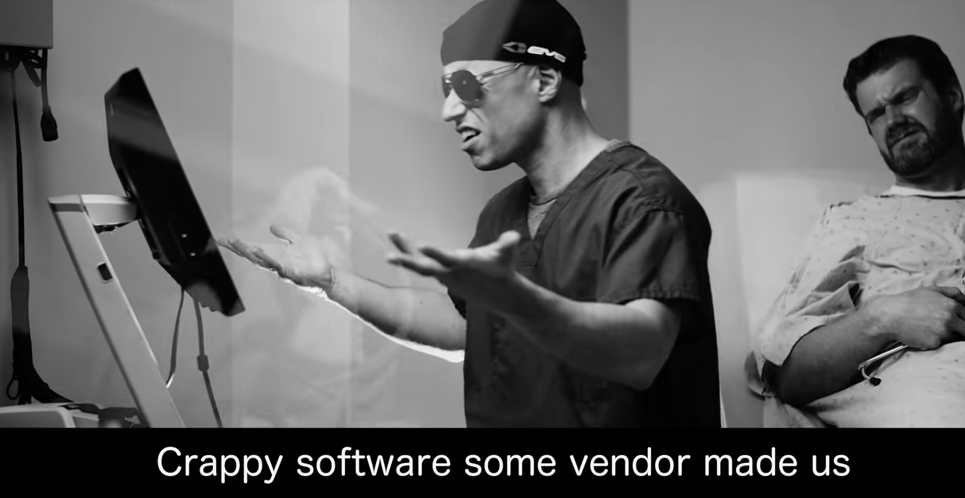
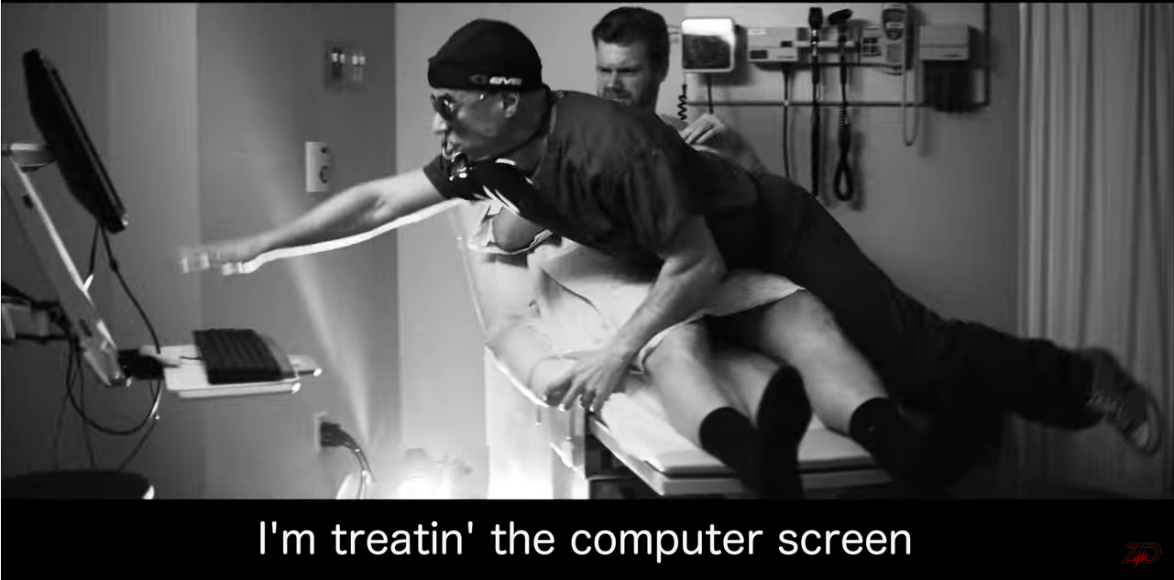
ZDOGG.MD

Slide 10
ZDOGG.MD
Admittedly, even Dr. Zubin Damania (ZDOGG) does NOT think we should go back to paper
He also still believes in the potential of the EHR

Slide 11
Nevertheless, there are undeniable realities:
Technology is going to continue to advance
(Most likely it will improve)
Patients, payers and new grads expect us to keep up
(We want to stay relevant and competitive)
The demands of healthcare delivery will keep changing
(Doing what we’ve always done will NOT get us what we’ve always gotten)

Slide 12
Undisputed Reality:
We MUST document.
Our options are:
Pen & Paper
Transcription
Electronic Documentation
Scribes

Slide 13
Another Reality:
To control costs—and respond to a shrinking industry…
…we must transition from
Dictation / Transcription
to
Electronic Documentation.

Slide 14
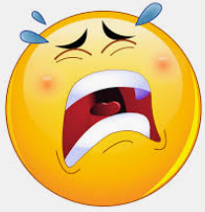

So…that leaves…
Pen and Paper
or
Electronic Documentation
(w/ or w/o scribes)

Slide 15
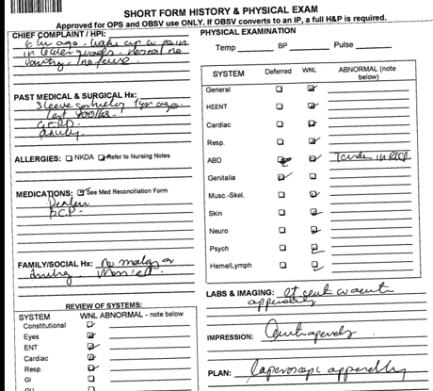
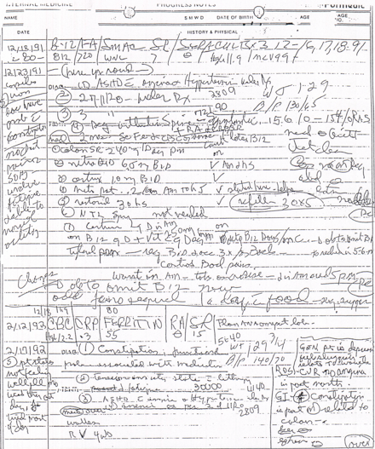

Slide 16
ZDOGG.MD
“We’ve lost the narrative we had on paper”

Slide 17
We’ve lost the narrative we had when we were on paper
EHRs facilitated a doc’s tendency to avoid the narrative.
Early EHR functionality PROMOTED the destruction of the narrative.
Newer technology & EHR functionality allows us to return to “telling the story” of the patient.
Ongoing challenge: Many of us are stuck using old technology.

Slide 18
Tools in EHR allow us to add extra chart data to our notes—compared to paper or transcription.
This extra chart data tends to:
BLOAT
OUR
NOTES

Slide 19
NOTE BLOAT
Is a provider preference
Not a requirement
There is NO
coding credit
or
medicolegal protection.

Slide 20
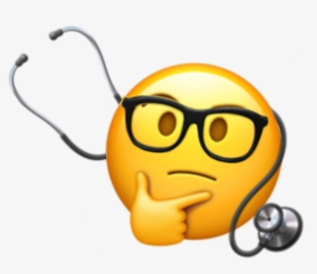

From a Coding and Medicolegal standpoint…
…we MUST document what we
THINK
and
PLAN TO DO
about the data / images.

Slide 21
From an efficiency and sanity standpoint…
…please DO NOT feel a prisoner to all the tagging and copy / pasting.
And PLEASE reflect on whether
“copy-forward”
is the ONLY way to be thorough & efficient.

Slide 22
What do we want from documentation anyways?
(Let’s leave “coding” out of the discussion for now)
We DO place HIGH value on seeing each others’ notes
I want to know what you:
Heard / saw / interpreted for our patient
Think is going on
Plan to do about it
Expect of me
I assume you want the same from me.

Slide 23
We should assume:
We all do our own Chart Review.
We look at radiology reports and lab values ourselves.
We really should NOT rely on each other’s notes for the source of truth about chart data.
(stuff changes, gets addendums, new results post)

Slide 24
The dilemma of the transition
Paper
Tells the story
Concise
Illegible
Dictation:
Tells the story (verbose)
Takes too long
Expensive
Electronic Documentation:
Note Bloat
Too many clicks
Unreadable / overly structured notes

Slide 25
The dilemma of the transition
Electronic Documentation:
Note Bloat
Too many clicks
Unreadable / overly structured notes

Slide 26
The dilemma of the transition
Electronic Documentation:
Note Bloat
Too many clicks
Unreadable / overly structured notes
Dynamic Documentation:
Tells the story
Immediately available
Very readable document
PowerNotes:
If you try hard—you can bloat your note.
Tagging
Copy / Paste
Long Auto-texts

Slide 27
Dynamic Documentation:
Currently used in Beacon Cerner:
Exclusively in ~95% BMG offices
Elkhart General ED now live
Beacon Granger ED now live (some MHSB ED)
Some adoption of EGH and MHSB hospitalists
(We still have design and build optimization to improve on what is available for hospital use)

Slide 28
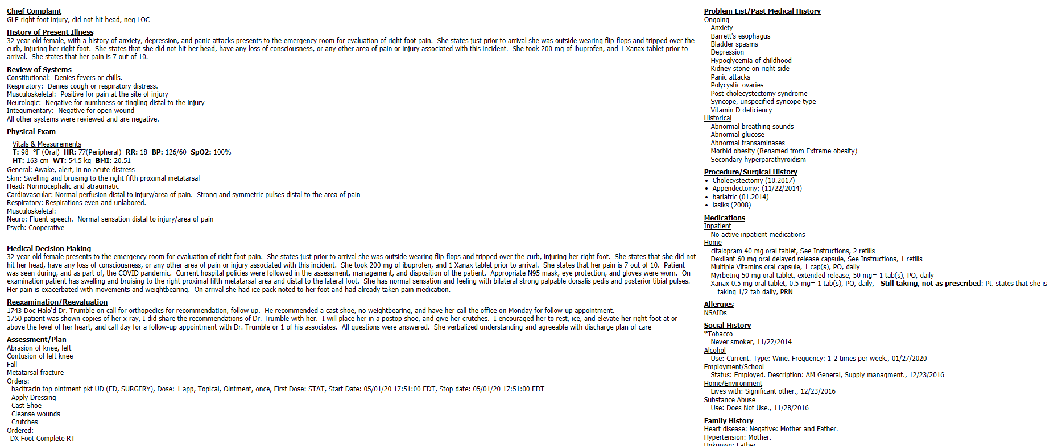
Example of ER Note using Dynamic Documentation

Slide 29
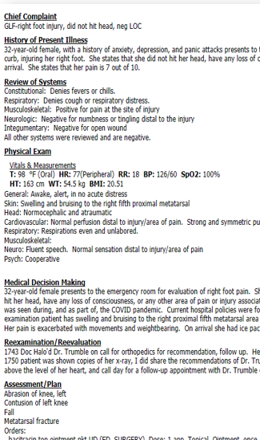
Chief Complaint
HPI
ROS
Physical Exam
Medical Decision Making
Re-examination / Reevaluation
Assessment / Plan

Slide 30
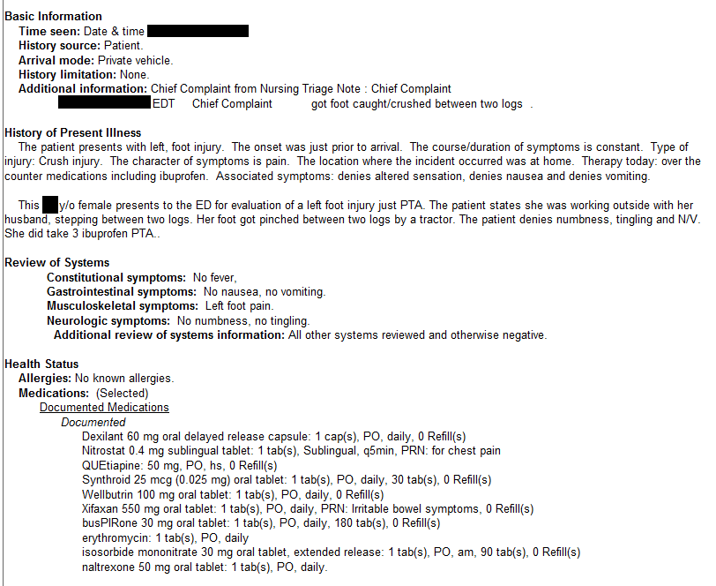
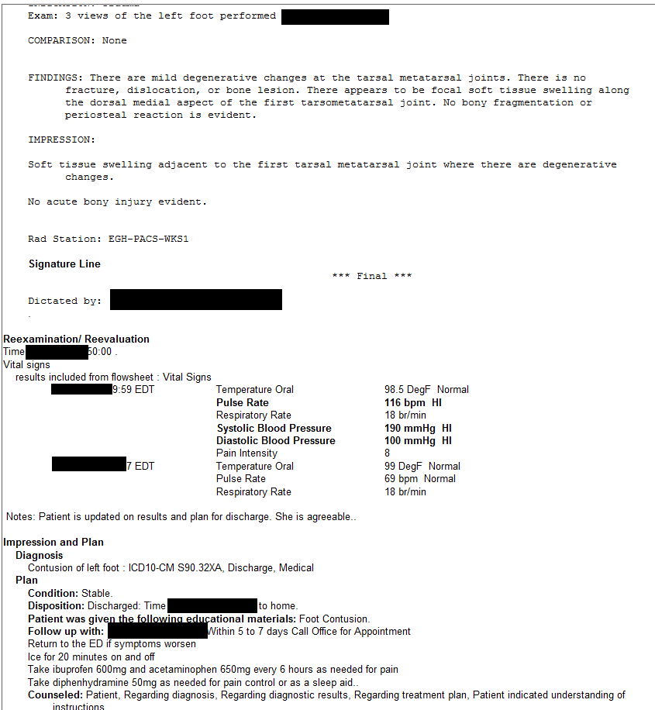
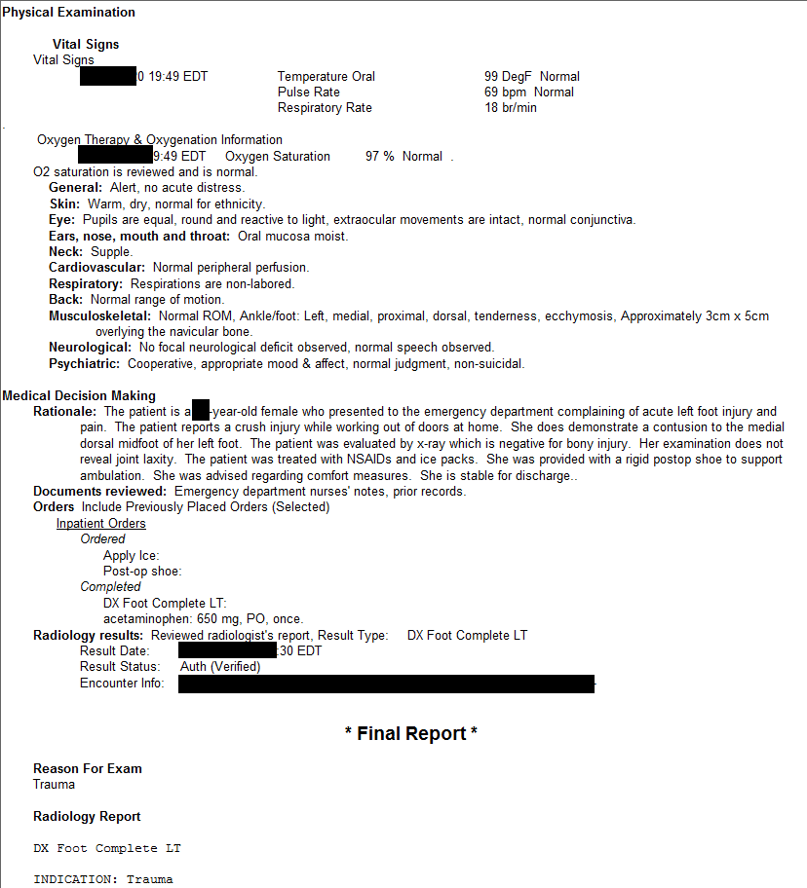
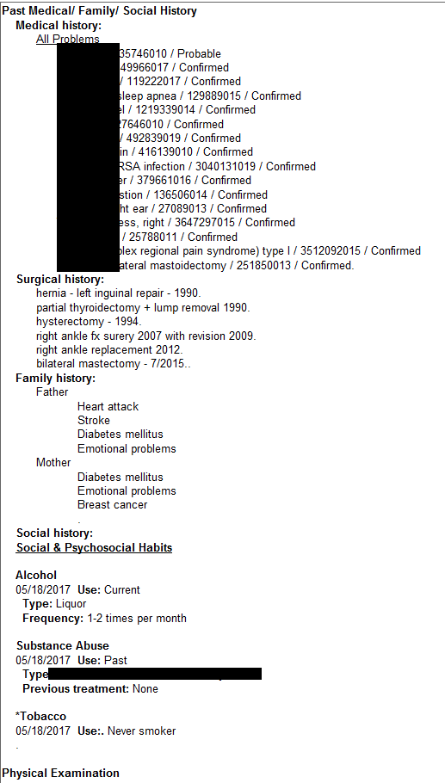
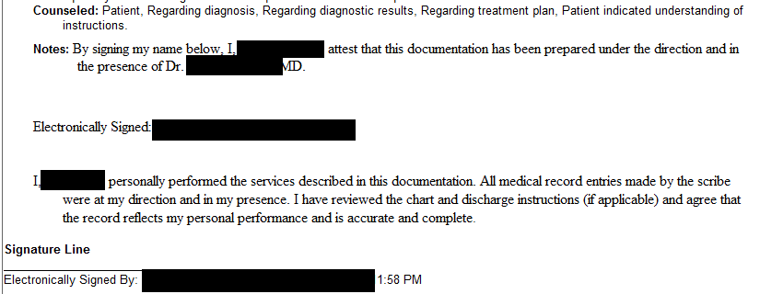
Example of ER Note using PowerNote

Slide 31
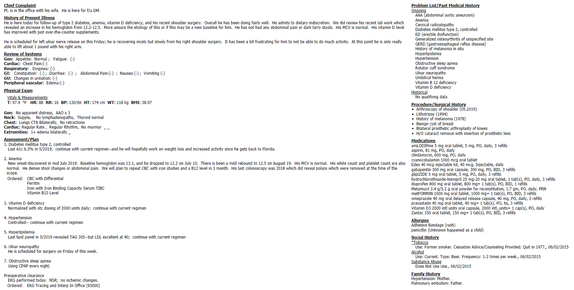
Example of Office Note with Dynamic Documentation

Slide 32
Moving from Transcription and PowerNotes to Dynamic Documentation requires engagement.
This is going to be change.
Change is hard.

Slide 33
Change is hard because it disrupts HABITS.
HABITS allow us to do parts of our job without thinking.
We want to think about our patient’s problems—not how to use the computer.

Slide 34
It is a GOOD investment in time to learn HOW to use
EHR Tools.

Slide 35
Beacon intends to implement
Dynamic Documentation
for all hospital activity.
This includes tools for a better experience with:
Documentation
Chart Review
Orders

Slide 36
Transcription Turnaround Time (TAT) Performance
2019
% Transcription meeting Turnaround Time | KEYSTROKE TRANSCRIPTION
 | January | February | March | April | May | June | July | August | September | October | November | December
 | 94.6% | 90.6% | 90.2% | 94.3% | 89.3% | 67.7% | 30.4% | 32.0% | 62.0% | 88.8% | 81.7% | 50.7%
2020
January | February | March | April
34.0% | 31.1% | 54.0% | 91.5%

Slide 37
Current Transcription TAT Status—by Note Type
May 2020 (as of 5/13) | Goal | Actual | % Met Goal
ER Note Immediate | 4 hrs
ER Note | 8 hrs
H&P | 2 hrs
Consult Note | 6 hrs
Operative Report | 12 hrs
Daily Progress Note | 4 hrs

Slide 38
Current Transcription TAT Status—by Note Type
May 2020 (as of 5/13) | Goal | Actual | % Met Goal
ER Note Immediate | 4 hrs | 12.9 hrs | 13.1%
ER Note | 8 hrs | 23.6 hrs | 30%
H&P | 2 hrs | 2.8 hrs | 63.3%
Consult Note | 6 hrs | 13.7 hrs | 23.4%
Operative Report | 12 hrs | 39.2 hrs | 13.3%
Daily Progress Note | 4 hrs | 10.4 hrs | 24.5%

Slide 39
STAT Dictation Requests
May 2020 (as of 5/13) | Goal | Actual | % Met Goal
ER Note Immediate | 1 hr
H&P | 1 hr
Consult Note | 1 hr
Operative Report | 1 hr
Daily Progress Note | 1 hr

Slide 40
STAT Dictation Requests
May 2020 (as of 5/13) | Goal | Actual | % Met Goal
ER Note Immediate | 1 hr | 6.6 hrs | 0%
H&P | 1 hr | 6.0 hrs | 11.1%
Consult Note | 1 hr | 6.7 hrs | 26.7%
Operative Report | 1 hr | 10.2 hrs | 37.5%
Daily Progress Note | 1 hr | 1.9 hrs | 36.0%

Slide 41
Based on projections of service availability and budget needs…
…we anticipate a full transition away from dictation by the end of 2021.

Slide 42
Still far from perfect.
Better than before.
Can’t wait for perfect.
Please engage.
It won’t get better by itself.

Slide 43
Let’s talk about Dragons…

Slide 44



Slide 45
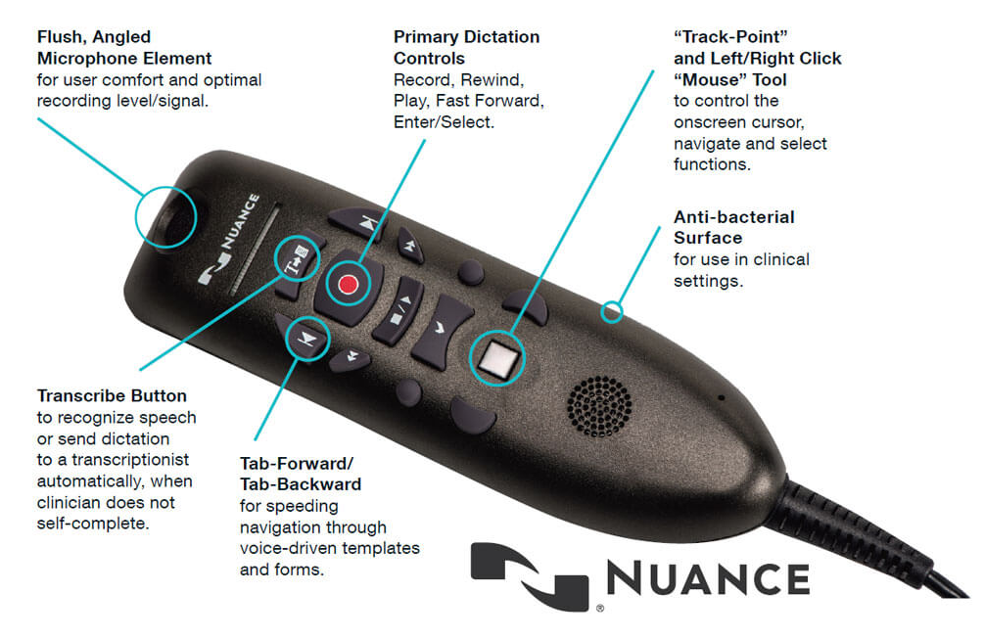
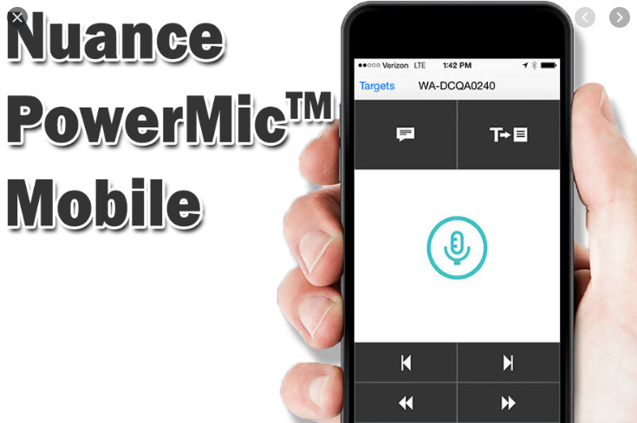
A Word on Dragon
Option 1:
Plug-in PowerMic
Option 2:
Cloud-based smart phone Mobile App

Slide 46
Dragon Take-Homes:
DMO is not perfect--but it’s pretty darn good—even with accents
Please don’t expect it to be perfect—you WILL get frustrated
It messes up names (until you train it) and pronouns
Yes—I’ve heard of M-Modal; competition is good
Both technologies are excellent—and both will get even better

Slide 47
Dragon Take-Homes:
It’s not human. But humans aren’t perfect either—and they take a lot longer to type what you say.
The more you put into it—the more you get out of it
Dragon auto-texts
Step-by-step commands
Most importantly: Use it to tell the story—not to copy & paste

Slide 48

Dragon Take-Homes:
Yes– it is important to proof-read and think about what you say…
Actual excerpts from dictated medical documents:
“Patient was alert and unresponsive”

Slide 49
Dragon Take-Homes:
Yes– it is important to proof-read and think about what you say…
Actual excerpts from dictated medical documents:
“She is numb from her toes down”

Slide 50

Dragon Take-Homes:
Yes– it is important to proof-read and think about what you say…
Actual excerpts from dictated medical documents:
“She has no rigors or chills, but her husband states
she was very hot in bed last night .”

Slide 51
Dragon Take-Homes:
Yes– it is important to proof-read and think about what you say…
Actual excerpts from dictated medical documents:
“Between you and me, we ought to be able to
get this lady pregnant.”

Slide 52

Dragon Take-Homes:
Yes– it is important to proof-read and think about what you say…
Actual excerpts from dictated medical documents:
“The patient has been depressed since
she started seeing me in 1993.”

Slide 53
Just like learning to dictate was a skill worth learning,
learning to use your Dragon well
is well worth the effort.

Slide 54
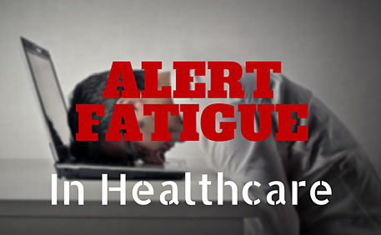

Slide 55
Goal: Actionable alerts fire for the:
Right person
for the
Right patient
at the
Right time

Slide 56
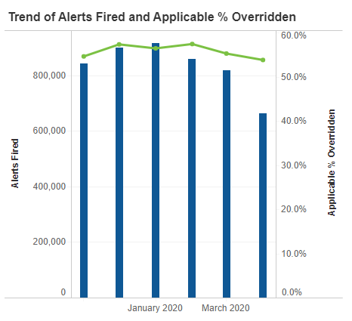
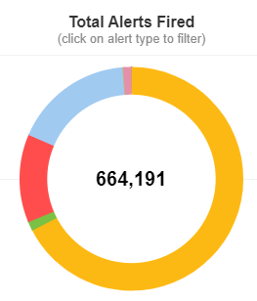
April, 2020

Slide 57
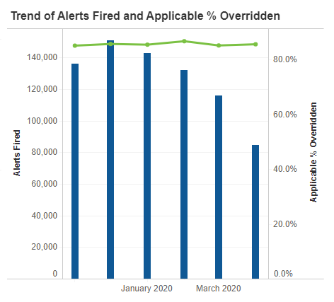
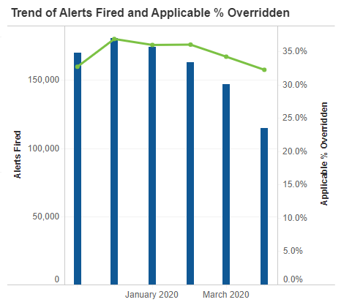
Drug-Drug
Drug-Duplicate
Drug-Duplicate:
114,792
Drug-Drug:
84,678

Slide 58
Leapfrog CPOE testing:
Intent: Measure the medication safeguards embedded in our EHR--while minimizing alert fatigue.

Slide 59
Leapfrog CPOE testing:
What’s measured?:
Do appropriate alerts fire during the med ordering process?
Do typically expected inappropriate alerts NOT fire?

Slide 60
Are these Alerts getting to the:
Right person
for the
Right patient
at the
Right time?

Slide 61
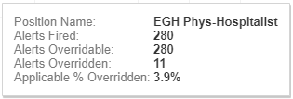
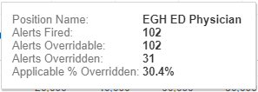
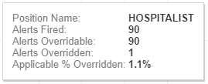
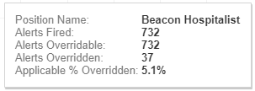
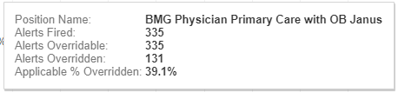
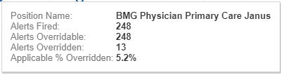
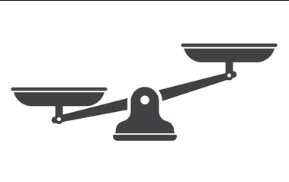
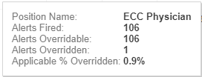
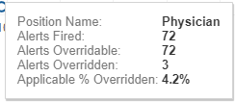
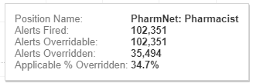
Beacon Pharmacists
Beacon Physicians
Total Alerts received by Physicians:
4,803
Total Alerts received by Pharmacists: 102,351
Drug-Duplicate

Slide 62
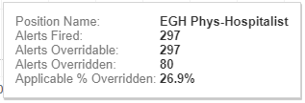
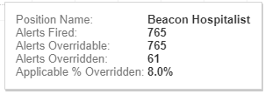
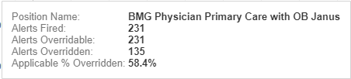
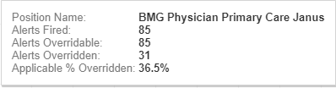
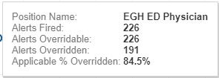
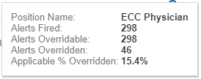
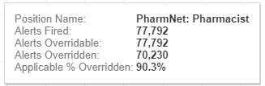
Total Alerts received by Physicians:
3,953
Total Alerts received by Pharmacists: 77,792
Drug-Drug

Slide 63
A well-intentioned, but flawed strategy
Pharmacists are human.
May assume the physician is already aware.
Likely don’t know the patient or the situation like the physician does.
Are busy too. The alerts force them to decide “Should I page the doctor about this?”

Slide 64
A well-intentioned, but flawed strategy
Despite the intention—
Despite >100,000 alerts per month—
Pharmacists are STILL not getting all of the applicable alerts.
Docs can still order:
KCl 20mEq Q 2 hours
Carbamazepine 200mg every hour
Bisacodyl 10mg IV x 1

Slide 65
Medication Safety:
Leapfrog testing categories:
Category | MHSB Score (2019) | EGH Score (2019)
Drug Dose (Single)
Drug Dose (Multiple)
Drug Route
Drug-Drug Interaction
Therapeutic Duplication
Drug Allergy
Drug Lab
Drug Monitoring
Drug Diagnosis
Drug Age
Total:

Slide 66
Medication Safety:
Leapfrog testing categories:
Category | MHSB Score (2019) | EGH Score (2019)
Drug Dose (Single) | 25% | 0%
Drug Dose (Multiple) | 0% | 0%
Drug Route | 25% | 0%
Drug-Drug Interaction | 25% | 0%
Therapeutic Duplication | 0% | 25%
Drug Allergy | 100% | 100%
Drug Lab | 0% | 0%
Drug Monitoring | 0% | 25%
Drug Diagnosis | 0% | Insufficient response
Drug Age | 0% | 0%
Total: | 18% | 16%

Slide 67
Two different flavors of Medication alerts:
Drug-Class Alerts
Drug-Drug
Drug-Duplicate
Drug-Allergy
Dose-Range Checking
Drug-Dose
Drug-Route
Drug Frequency
Drug-Age
Drug-Lab
Drug-Problem
Drug-Monitoring

Slide 68
Two different flavors of Medication alerts:
Drug-Class Alerts
Drug-Drug
Drug-Duplicate
Drug-Allergy
Dose-Range Checking
Drug-Dose
Drug-Route
Drug Frequency
Drug-Age
Drug-Lab
Drug-Problem
Drug-Monitoring

Slide 69
Drug-Drug Interactions
have different
“Levels of Severity”
Minor
Moderate
Major
Major Contraindicated
These are defined by various pharmacy industry leaders

Slide 70
Drug-Drug Interactions
have different
“Levels of Severity”
Minor
Moderate
Major
Major Contraindicated
This is ALL that physicians see today.

Slide 71
Beacon’s plan is to turn on the “Major” Drug-Drug interaction alerts for physicians and nurses.
This is Cerner’s and Leapfrog’s recommendation.
“Dose Range Checking” for individual drugs will also be addressed.

Slide 72
It’s recognized this activity will increase the volume of alerts presented to physicians and nurses.
This will be coupled with commitment to reduce and improve upon non-medication alerts.

Slide 73
Pharmacists are not the only ones getting alerts…
Drug-Duplicate:
114,792
“Other”:
447,526
Drug-Drug:
84,678

Slide 74
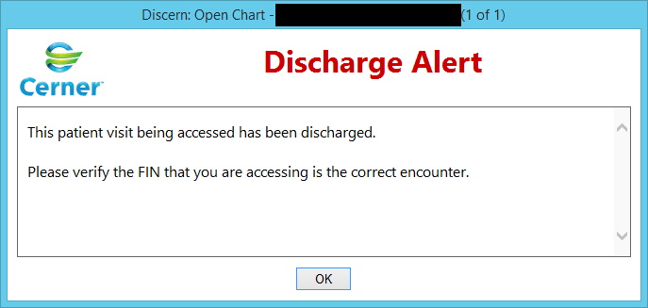
April, 2020: 260,946 times

Slide 75
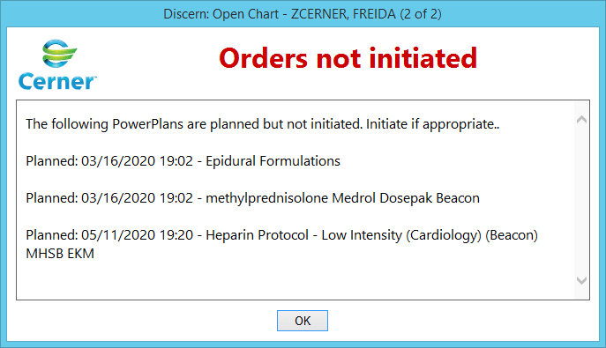
April, 2020: 45,025 times

Slide 76
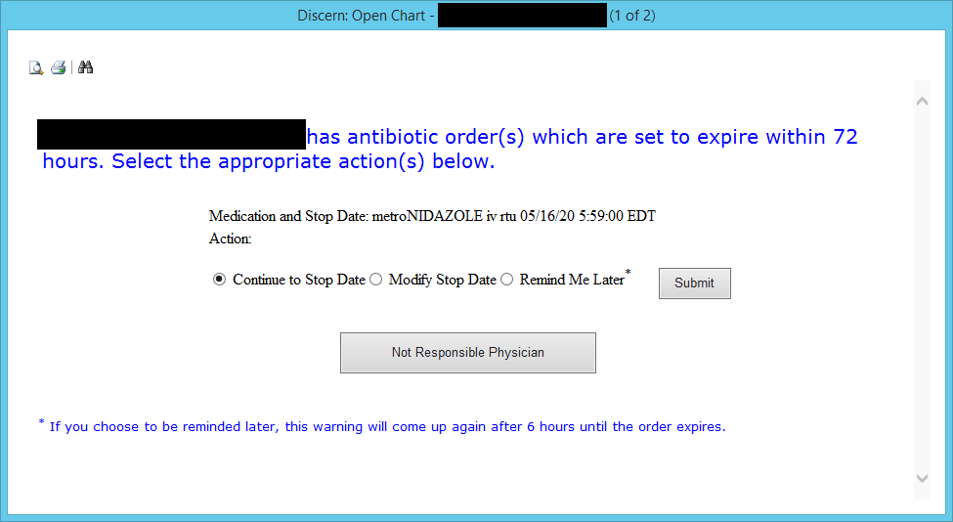
April, 2020: 8,025 times
(One poor doc got this alert 266 times)

Slide 77
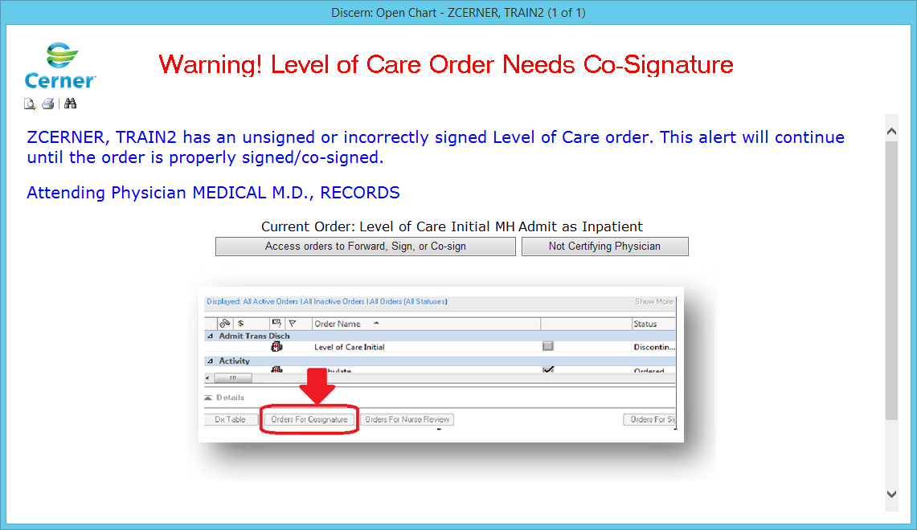
April, 2020: 3,578 times

Slide 78
Again--commitment to reduce and improve upon non-medication alerts.

Slide 79
Tips
&
Tricks

Slide 80
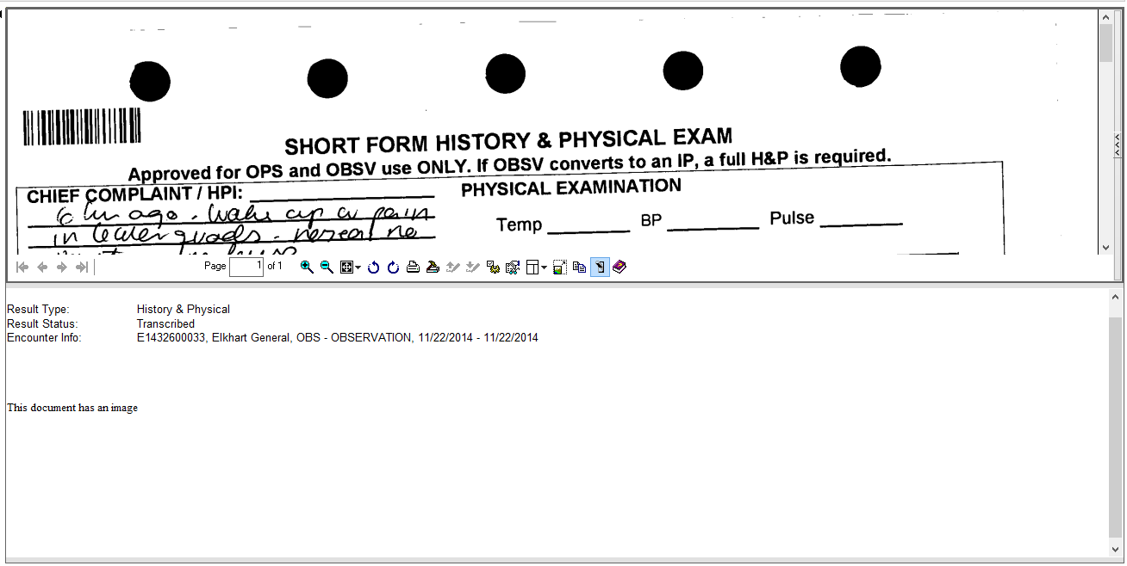

Scanned documents

Slide 81
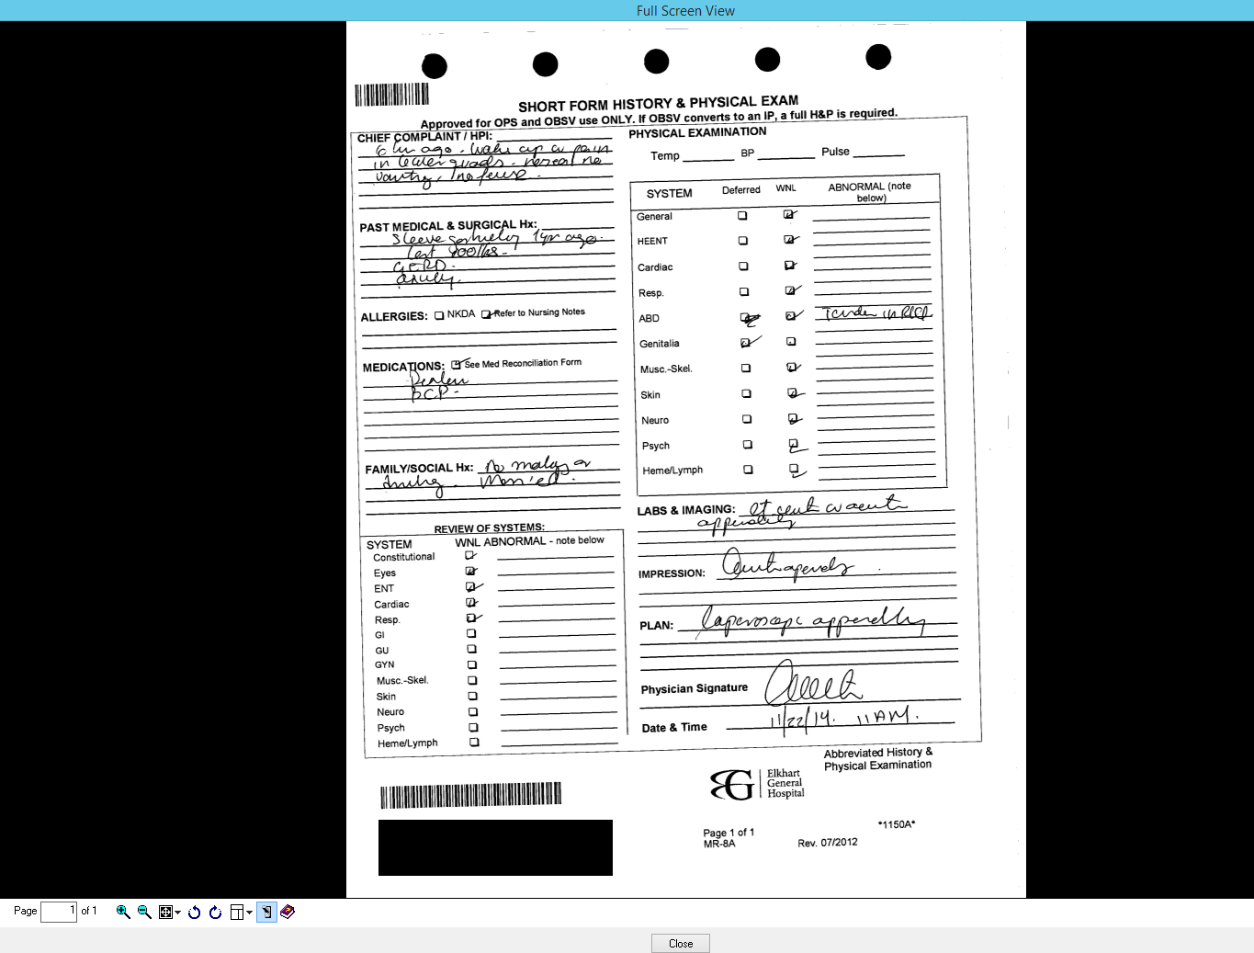

Slide 82
“Documentation Accelerators”
Cerner Auto-Texts
Dragon Auto-Texts
Dragon Step-By-Step Commands

Slide 83
Auto-Texts:
Available in Dragon and in Cerner.
In Cerner, learn to leverage the “Drop-Lists”

Slide 84
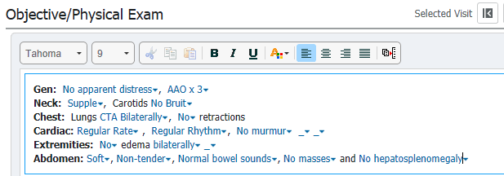


Slide 85
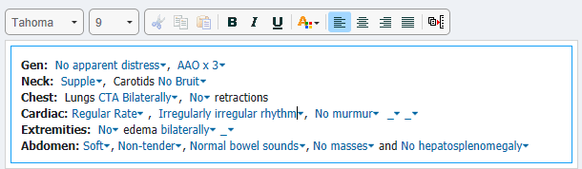

Slide 86
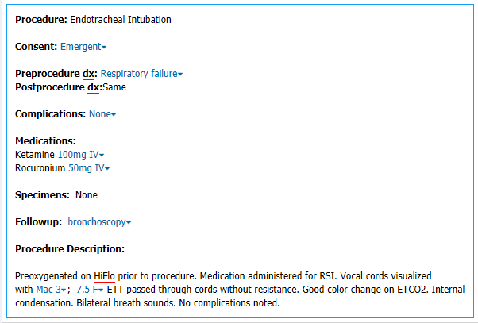


Slide 87



Slide 88


Slide 89

How do I make an Auto-Text again?

Slide 90


Slide 91
Revenue Cycle
Registration
Scheduling
Accounting
Coding / Documentation
Charge Services
Billing
HIM

Slide 92
EGH STAR
MHSB STAR
EGH PHS
MHSB PHS
Allscripts ProPM
Cerner
PowerChart
FirstNet
PathNet
RadNet
SurgiNet

Slide 93
EGH STAR
MHSB STAR
EGH PHS
MHSB PHS
Allscripts ProPM
Beacon PACS
Beacon Ancillary Applications
Enterprise Master Patient Index
EGH Ancillary Applications
Cerner
PowerChart
FirstNet
PathNet
RadNet
SurgiNet
MHSB Ancillary Applications

Slide 94
EGH STAR
MHSB STAR
EGH PHS
MHSB PHS
Allscripts ProPM
Beacon PACS
Beacon Ancillary Applications
Enterprise Master Patient Index
EGH Ancillary Applications
Cerner
PowerChart
FirstNet
PathNet
RadNet
SurgiNet
MHSB Ancillary Applications

Slide 95
Single database
Single source of truth
Drives standardization
Beacon Ancillary Applications
Cerner’s
“Clinically Driven Revenue Cycle”
Beacon PACS
EGH Ancillary Applications
Cerner
PowerChart
FirstNet
PathNet
RadNet
SurgiNet
MHSB Ancillary Applications

Slide 96
Revenue Cycle Goals:
Improved consistency
System interface reduction
System predictability
Enhanced portal functionality
Improved patient experience
Provider/Service Directory search
Registration efficiencies gained

Slide 97
Thank you!!!
Questions???

