Slide 1

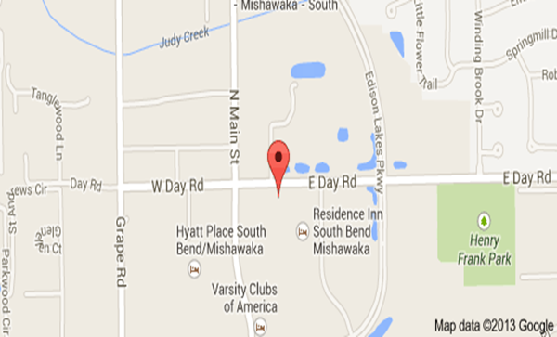
Memorial Hospital of South Bend
(Cancer Care Partner Bldg.)
301 E. Day Rd
Mishawaka, In 46545
(574) 204-7322
Diet Instructions start the “day before” your appointment
*No sugar in your diet the day prior to your appt. (starting approx. 2:00 pm)
Meal Suggestions:
Baked or Broiled Meats (Beef, Chicken, Seafood, Pork)
Green Vegetables – Eggs
Plenty of Water
Absolutely NO Carbs
*Do not eat or drink anything (except water) for
4 hours before the exam
*Drink as much water as you can the day of exam
*All Medications should be taken 4 hrs prior to your
arrival time the day of PET Scan
*NO heavy exercise for 48 hours prior to appt.
Appt. Date _________________
Arrival Time:________________
If you are diabetic, your blood sugar must be below 200 in order for us to do the scan.
*DO NOT take insulin within 4 hrs. prior to your test time. Diabetic patients are encouraged to test their blood sugar before their appt., if it is above 200 call us at 574-204-7322.
(Be aware that proper management of your blood sugar is more important than strict adherence to this diet.)

